Slide 1


#Greener AHPs
Jessie Frost
Chief Sustainability Officer's Clinical Fellow
April 2023

Slide 2
Aims
Why AHPs should get involved
National #GreenerAHP work: Focus 4 AHPs Deliver
Examples of Greener AHP initiatives
Ways to get involved
How to share and showcase what you’re doing
Resources
Q & A and opportunity to share best practice examples

Slide 3
Why get involved
As the third largest clinical workforce in the NHS, AHPs have a huge opportunity to contribute to a Greener NHS, tackle climate change and improve health
Much of the work that AHPs do is already contributing to a greener health service
Focus 4 of AHPs Deliver (2022 – 2027)
Health and Care Act 2022
Notes:
As the third largest clinical workforce in the NHS with more than 195,000 AHPs delivering health and care services in England, AHPs have a huge opportunity to contribute to a Greener NHS, tackle climate change and improve health. Much of the work that AHPs do as business as usual is already contributing to a greener health service

Slide 4

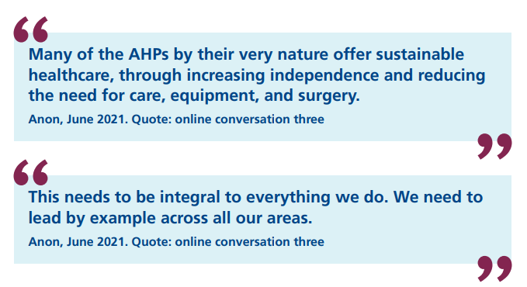
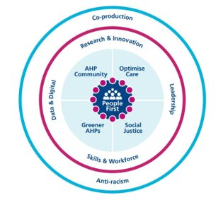
AHPs Deliver Strategy 2022 – 2027:
Focus 4 Greener AHPs: crowdsourced > 900 responders
The ambitions for environmental sustainability are:
Workforce
Models of care
Resource use
Notes:
Crowdsourced and based on a large survey of over 900 people (AHPS, support workforce, Public and patient involvement)
The three ambitions for environmental sustainability in the strategy are broad in scope.
Workforce: Embedding new ways of working by incorporating net zero into everything we do. To achieve this, all AHPs will need a good understanding of the net zero agenda
Models of care: Including net zero as a fundamental principle in our models of care.
Resource use: Actively considering and reducing the environmental impact of the things we procure and prescribe as part of our practice, not just thinking about recycling and waste
Paramedic and ODP colleagues use medical gases like nitrous oxide and administer meds on board their vehicles, radiographers use iodinated contrast media in diagnostic imaging, advanced practitioners make imaging requesting like MRIs or videofluoroscopy, orthotists/prosthetists producing and prescribe plastic orthoses /insoles/spinal braces/specialist footwear, single use medical instruments used in small scale podiatric surgery, physios and Ots prescribing walking aids/standing frames/specialist seating/hoists, recommend home adaptations, dietitians prescribe enteral feeding equipment and fortified milk, SLTs prescribe communication devices

Slide 5







Education, regulators and professional bodies
Curricula: pre and post registration
HCPC: SCPEs
Greener AHP advisory group
Communications & networks
Lunch & Learn
Connecting with GNHS regions
Centre for Sustainable Healthcare networks
Awareness raising
Case studies
Greener AHP hub
Production of an animation for AHPs by AHPs
Greener AHP week
National Greener AHP work
Notes:
Education
Development of a guidance document to support the incorporation of environmental sustainability into pre-registration curricula across all Allied Health Professions in the four UK home nations: wide group of stakeholders across the 4 nations including academics, clinicians, students, Council of Deans, AHPF
Working in an advisory capacity to the HCPC and with HEE to support the incorporation of environmental sustainability into SCPEs, standards of proficiency, and both the preceptorship and multi-professional advanced practice frameworks
Communication & networks
Proposition to deliver a ‘lunch and learn’ environmental sustainability webinar to your region in collaboration with the HEE/NHSE regional leads, to support each region with Focus 4 of AHP’s Deliver.
- CSH networks
Awareness raising:
The hub highlights how a lot of AHPs existing practices already contribute to a greener health service, for example, practicing within sustainable models of care, but there is much still to do.
The Greener AHP Hub will help people find out how they can take action to help do more and make their practice greener.
Ongoing work to develop the Greener AHP hub, including curating and promoting case studies from all AHP groups across the four UK home nations
Production of an animation weaving together climate change and public health; coproduced by AHPs for AHPs; this work is being led by West Yorkshire ICB
Delivery of a ‘Greener AHP’ week, further to the CAHPO conference in a similar vein to #WeAHPsActive

Slide 6
Examples of small every-day actions and Greener AHP initiatives

Slide 7



Small every-day actions / Sustainable Quality Improvement projects / low carbon models of care / carbon foot printing
Early mobilisation in CICU Southampton
Community e-bikes Sussex
Paper reduction and engaging the workforce
‘The gloves are off’ campaign
Pandemic Innovation: A Home-Visiting Service for Laryngectomees
Saving Turtles, University Hospitals Coventry and Warwickshire
Singing for Health, Northern Ireland
Walking aid reuse schemes, physical therapy services
Use carbon calculators Sustainable Healthcare coalition Care pathways carbon footprint calculator and Healthcare lifecycle assessment database
Using content of your email signature to communicate key messaging or resources e.g. links to e-learning, carbon footprint of an email attachment
Using QR codes and website links to self-help info where possible instead of printing
Incorporating ES into curricula and student placement projects
Reusable instead of single use: straws, masks, drapes, biodegradable aprons NHS Single-Use Plastics Reduction Campaign Pledge
Orthotics team, The Royal Wolverhampton NHS Trust
GOSHpods goes Green: Green champions & period pants

Slide 8
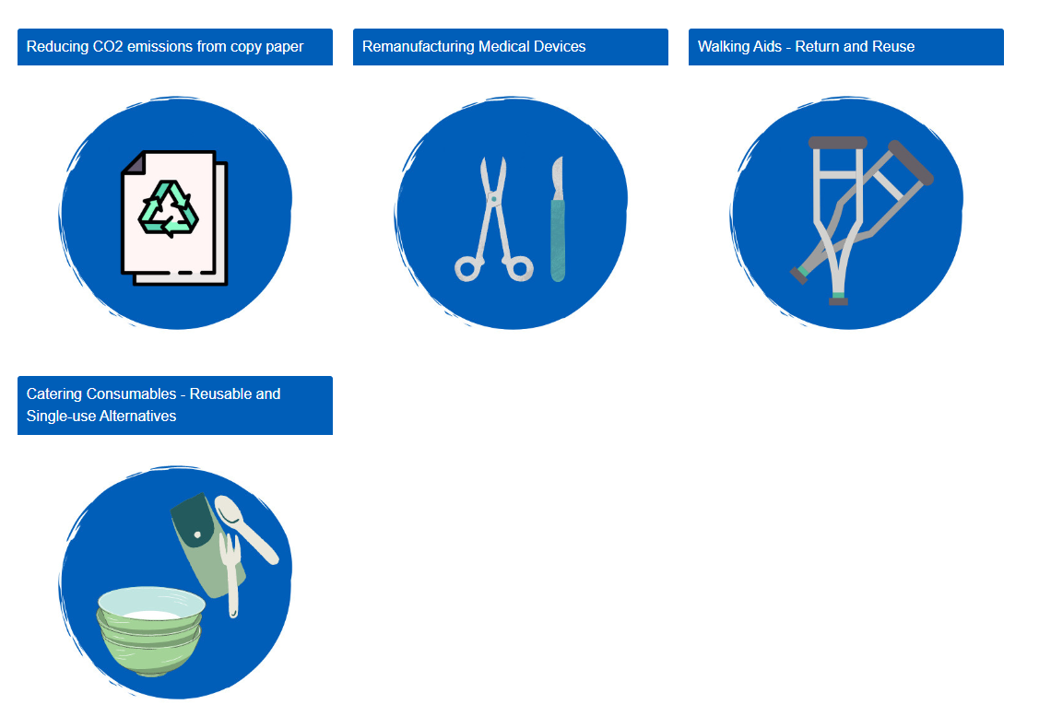


Using and contributing to research & guidelines; funding examples
Telehealth patient consultation guidelines and training
Green Theatre Checklist
How to guides on CCF
Healthier Futures Action Fund
SBRI healthcare funding
NHS forest free trees!

Slide 9
Ways to get involved

Slide 10



Knowledge
Trust / ICB green plans
E-learning for healthcare modules
M Level study examples: LSHTM, University of Hull, University of Brighton, University College London
Centre for sustainable healthcare short courses
The Carbon Literacy Project
Sustainability Leadership for Greener Health and Care Programme - NHS Leadership Academy
GNHS learning hub
Notes:
e-learning for healthcare modules: building a net zero nhs, environmental sustainability in QI and environmental sustainability in Dentistry
Lots of new M Level modules or MSc programmes being built including these examples

Slide 11


Advocacy and awareness raising
  Health Declares: how to influence trusts, systems, professional bodies, regulators
  Climate change and health scorecard
  Sustainability web pages from professional bodies: has your professional body got anything on their website?
  Submit to HCPC consultations
  Planetary Health report card
Notes:
Using your trusted AHP voice to influence local and national health organisations, professional bodies, HEIs, regulators

Slide 12


Education, workforce development & curricula
  Sustainability Matters: Guiding Principles for Sustainability | WFOT
  Environmental Physiotherapy Association EPT Agenda 2023
  One Blue Dot - the BDA's Environmentally Sustainable Diet Project
  Medical Schools Council Education for Sustainable Healthcare
  Incorporate sustainability into QI projects for all learners
  Signpost colleagues and students to elfh module
  Encourage student engagement and initiatives within HEI
  Council of Deans of health guidance document for AHP pre-reg curricula: August 2023

Slide 13


Networks, fellowships, additional roles & jobs
Join profession specific and AHP sustainability networks on CSH
Link with your AHP councils and faculties
Ask your trust, system or regional Chief AHP what they’re doing to implement Focus 4 of AHPs Deliver
Link with your Trust / system sustainability team: set up a SIG
Join a Green champion network and become a Green champion for your trust / system
Link with Greener NHS regional teams
Get a FutureNHS Collaboration Platform account and join these workspaces
  Greener AHP Forum - National AHP Virtual Hub
  Greener NHS Community
Chief Sustainability Officer's Clinical fellowship scheme
Apply to health and care sustainability jobs
Notes:
Elizabeth Fitzhugh clinical lead net zero & ODP;
Alexis Percival sustainability manager and paramedic
Peter May; Net Zero Policy & Delivery Manager Greener NHS and NHSE
Ben Whittaker; Mental Health Lead/AHP Lead THE CENTRE FOR SUSTAINABLE HEALTHCARE
Jim Hewins Environment and Sustainability lead for Chiltern music therapy Music Therapist

Slide 14
How to share and showcase what you’re doing

Slide 15

Sharing and showcasing your work
Let’s build a central repository: work smart, not hard!
Share what you’re doing with:
    Your own trust or system sustainability team
    CSH using their case study templates
    CAHPO Greener AHP hub: england.cahpo@nhs.net
    Regional GNHS team
    National GNHS greener.nhs@nhs.net
    Enter the Greener AHP CAHPO award category
    Get involved in the CSH Green Ward Competition
Are there any networks missing?
    East of England region plan to create a regional Greener AHP network
    ?Support workers network

Slide 16
Greener resources and training
Reports/reference documents
‘Delivering a ‘Net Zero’ National Health Service’ report
The Lancet Countdown on health and climate change
The Health and Care Act 2022
AHPs Deliver
Futures NHS workspaces / pages
National AHP Virtual Hub - Greener AHP forum
Greener NHS Knowledge HubCentral Commercial Function (CCF) Hub​
  Walking Aids How to Guide
  Copy Paper How-to Guide
  Medical Device Remanufacture How-to Guide
  Catering Consumables How-to Guide
Training / learning resources
E-learning for healthcare module ‘Building a Net Zero NHS’
Greener NHS Training hub on FutureNHS; brings together a variety of training and educational offers
Websites
Greener Allied Health Professional hub
AHPs Deliver Focus 4 implementation framework
Greener NHS Website
  Subscribe to the Greener NHS E-bulletin
Centre for sustainable healthcare (CSH)
UK Health Alliance on Climate Change
Sustainable Healthcare coalition Care pathways carbon footprint calculator
Healthcare lifecycle assessment database

