Slide 1
Nature as co-therapist in nature-based arts therapies
Dr Zoe Moula
Lecturer in Mental Health, King’s College London
Editor-in-Chief Designate, International Journal of Art Therapy

Slide 2
A bit about myself…
Originally trained as a teacher (Greece)
Followed by training in therapeutic play (Wales)
Training in clinical research (Scotland)
PhD in school-based art therapies (England)
Post-doc in arts-in-nature (England)
Currently interested in/researching nature-based arts therapies

Slide 4
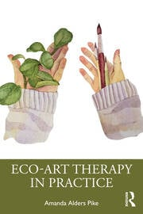
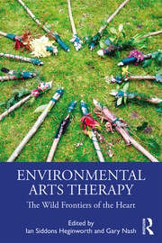
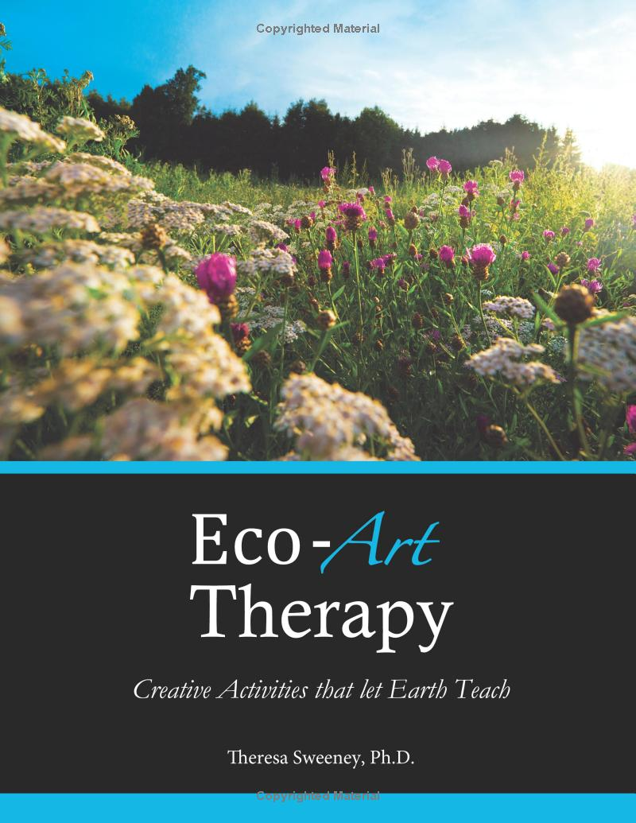
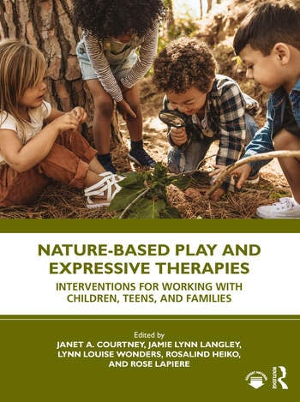
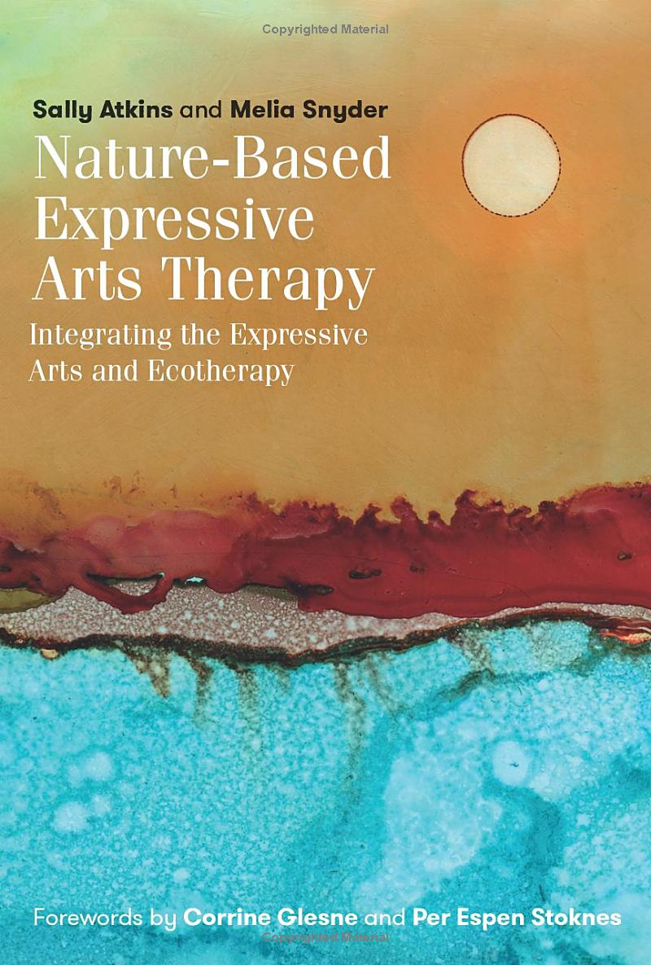
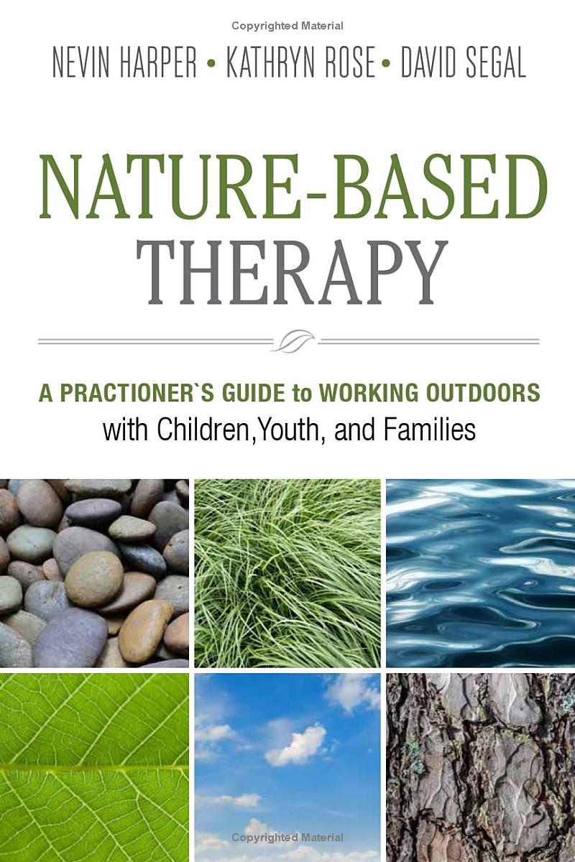

Slide 5
Starting with the definitions
Nature-based arts therapies
Outdoor-based arts therapies
Eco-art therapies
Environmental arts therapies
Climate-informed arts therapies
What do you think is the difference between them?

Slide 6
Eco-philosophy
All definitions are theoretically underpinned by eco-philosophy.
The turn from an anthropocentric (human-centered) worldview to an ecocentric (nature-centered) worldview (Stoknes, 2015).
In an ecocentric worldview each being has sentience, inherent value and meaningful existence. Human beings are not separate/superior.
Partnership with nature for the joint purpose of healing both human and natural systems (Harper et al., 2019).

Slide 7
Eco-therapy
The umbrella term for the application of ecopsychology.
Nature becomes the ‘co-therapist’.
Emphasis on the human – nature relationship (Buzzell & Chalquist, 2009).
Emphasis on the reciprocal process whereby healing in nature is also healing for nature (Rust, 2009).

Slide 8
Mechanisms of change

Slide 9
Gaining perspective
Nature allows us to recall and describe different types of memories which engage both cognitive and perceptual neural pathways (Vance & Wahlin, 2008).
We can “stand back and look at our lives as a whole,” gaining insight into what could improve our life (Stace, 2016).
Our creative problem-solving skills have also been found to increase in nature, sometimes by as much as 50% (Berman et al., 2008).

Slide 10
Safe expression
Natural materials allow safer expression of aggression (Sholt & Gavron, 2006).
“Breaking a stick is not the same as breaking a paintbrush or a pencil. It gives licence and a container for healthy expression of anger not directed at themselves, the therapist or the room. The sense of potency and control that comes with this, such as in the creation of mess and the symbolic expressions of defense, is a necessary part of moving through anger to fear and grief beneath.”
(Boon, 2020)

Slide 11
Nature as co-therapist
Nature as ‘co-therapist’ help us to safely approach existential themes of life, death, change, renewal, loss and new beginnings (Boon, 2020).
Internal feelings are projected out onto nature and given form or voice, which facilitates our capacity to mentalise and take a reflective stance towards our experience (Ponton, 2020).
“As we begin to understand more of our own wounds, we may begin to better understand the wounds that we inflict upon our planet” (Secretan, 2020).

Slide 12
“However large or small, these felt experiences can become deeply symbolic, standing for something hidden, dark, disturbing, shameful or repressed. When our exposure within nature becomes too much – too cold, too wet, too mucky, too dry, too hot, too prickly, too vast or too emotional – then we meet an edge between one’s self and one’s limits. Here there are opportunities and challenges, a place to be tested, to push further, a place where we might challenge and redefine our sense of self.”
(Eagleton, 2020)

Slide 13
Positioning emotions spatially
Think of emotions as relational flows, fluxes or currents between people and places, rather than towards things or objects – thus position emotions ‘spatially’.
The value and symbolic importance of places is related to our emotional associations with them and the feelings they inspire.
This helps us to understand the experience we have of places and the emotional experiences that our clients may have in relation to the spaces that we work in.
(Jordan, 2016, p.63, cited in Eagleton, 2019)

Slide 14
Calmness
The “grounding” effect of nature elicits connection with the earth, calming our senses and our brain (Berman et al., 2008).
Traumatic and stressful images and memories are stored in the limbic systems of our brain (Berman et al., 2008). Since the limbic system is linked to our central nervous system, and since nature can calm our nervous system, being in nature plays a central role in our reaction to stressful situations and recollections of traumatic experiences.
Because of the connection between our skin receptors and our central nervous system, even a simple act of a gentle breeze against our skin can relax our nervous system (Kopytin & Rugh, 2017).

Slide 15
Cycle of connection to nature (Moula et al., 2022)
Being in nature
Increased nature connectivity
Nature as part of identity
Environmental awareness
Pro-environmental behaviour
Environmental sustainabiliy

Slide 16
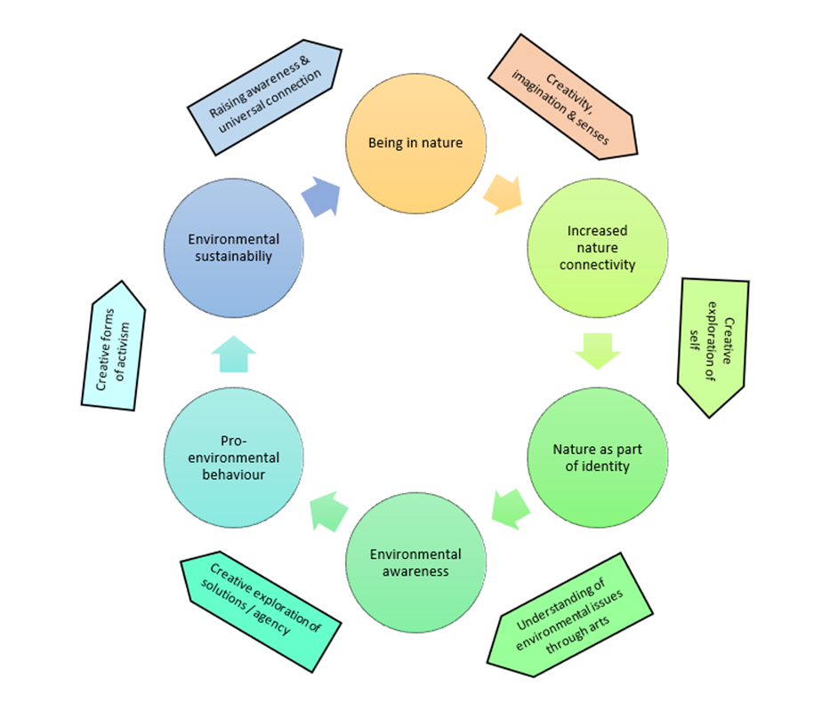
Cycle of connection to nature through the arts (Moula et al., 2022)

Slide 17
Evidence from neuroscience

Slide 18
Impact on body
Decrease of blood pressure which has been associated with decreased risk of cardiovascular and chronic diseases, anxiety, depression, chronic pain, and obesity (O’Malley, 2020).
Our skin receptors connect to the central autonomic nervous system which affects our self-regulation and cardiovascular health (Kopytin & Rugh, 2017; Cozolino, 2006).
As such, even a simple act of a gentle breeze against our skin can relax our nervous system and improve our self-regulation.
A whole new field of scientific inquiry ‘epigenetics’ explores how experiences in the environment affect genetic coding (Kumsta, 2019).

Slide 19
Impact on sleep
Poor sleep can lead to impaired motivation, emotion regulation, declines in cognitive functioning and increased risk for serious medical conditions like diabetes, cardiovascular disease, and cancer (Irish et al., 2015).
Sleep is triggered internally by the release of neurotransmitters and it is impacted by sun exposure given its role in maintaining a healthy circadian rhythm (Choi et al., 2020).
Exposure to natural light can therefore improve sleep.

Slide 20
Impact on immune system
Being in nature impacts our immune system through a range of mechanisms:
early contact with nature in childhood builds a more robust immune system through exposure to germs that can help develop a balanced immune response
regular contact with particular green environments, such as conifer forests, has been found to boost immune functions through exposure to phytoncides
children who played outdoors were made more biodiverse and showed improved immune markers in blood and skin

Slide 21
Impact on stress relief and calmness
Creating art using natural materials triggers restorative neurochemicals, meaning the process in and of itself is relaxing and de-stresses people (Williams, 2016).
Traumatic and stressful images and memories are stored in the limbic systems of our brain (Berman et al., 2008). Since the limbic system is linked to our central nervous system, and since nature can calm our nervous system, being in nature plays a central role in our reaction to stressful situations and recollections of traumatic experiences.

Slide 22
References
Stoknes, P.E. (2015) What we think about when we try not to think about global warming. Chelsea Green Publishers: USA
Harper, N.J., Rose, K., Segal, D. (2019) Nature-based therapy: A practitioner’s guide to working outdoors with children, youth, and families. New Society Publishers: Canada
Buzzell, L., Chalquist, C. (2009). Ecotherapy: Healing with nature in mind. Sierra Club Books: USA.
Rust, M. J. (2009). Why and how do therapists become ecotherapists? In L. Buzzell, & C. Chalquist (Eds.) Ecotherapy: Healing with nature in mind (p. 39). Sierra Club Books: USA
Berman, M.G., Jonides, J., Kaplan, S. (2008) The cognitive benefits of interacting with nature. Psychological Science, 19, 12, pp. 1207-1212. https://doi.org/10.1111/j.1467-9280.2008.02225.x

Slide 23
References
Sholt, M., Gavron, T. (2006) Therapeutic qualities of clay-work in art therapy and psychotherapy: A Review. Art Therapy, 23, 2. https://doi.org/10.1080/07421656.2006.10129647
Boon, L. (2020) The wild inside: Offering children natural materials and an ecopsychological understanding of self within art therapy. In I.S. Heginworth & G. Nash (Eds) Environmental arts therapy: The wild frontiers of the heart. Routledge: UK.
Ponton, L. (2020) EarthWays: Environmental arts therapy for repairing insecure attachment and developing creative response-ability in an insecure world. In I.S. Heginworth & G. Nash (Eds) Environmental arts therapy: The wild frontiers of the heart. Routledge: UK.
Secretan, W. (2020) The wood between the worlds: Encountering the wounded healer in environmental arts therapy. In I.S. Heginworth & G. Nash (Eds) Environmental arts therapy: The wild frontiers of the heart. Routledge: UK.

Slide 24
References
Eagleton, A. (2020) The tapping on the window: Environmental arts therapy and the integrated self. In I.S. Heginworth & G. Nash (Eds) Environmental arts therapy: The wild frontiers of the heart. Routledge: UK.
Kopytin A., Rugh M. (2017). Environmental expressive therapies: Nature-assisted theory and practice. London: Routledge.
Moula, Z. Palmer, K., Walshe, N. (2022) A systematic review of arts-based interventions delivered to children and young people in nature or outdoor spaces: Impact on nature connectedness, health and wellbeing. Frontiers in Psychology. 13: 858781. https://doi.org/10.3389%2Ffpsyg.2022.858781
Cozolino, L. J. (2006). The neuroscience of human relationships: Attachment and the developing social brain. Norton & Co: USA

Slide 25
References
Kumsta, R. (2019). The role of epigenetics for understanding mental health difficulties and its implications for psychotherapy research. Psychology and psychotherapy: Theory, research and practice, 92, 1. https://doi.org/10.1111/papt.12227
Irish, L.A., Kline, C.E., Gunn, H.E. et al. (2015) The role of sleep hygiene in promoting public health: A review of empirical evidence. Sleep medicine reviews, 22, 23–36. https://doi.org/10.1016/j.smrv.2014.10.001
Choi, J.H., Lee, B., Lee, J.Y. et al. (2020). Relationship between sleep duration, sun exposure, and Serum 25-Hydroxyvitamin D status: A cross-sectional study. Scientific reports, 10, 1, 4168. https://doi.org/10.1038/s41598-020-61061-8

Slide 26
Thank you ☺
Feel free to contact me at zoe.moula@kcl.ac.uk or Twitter @DrZoeMoula

