Slide 1
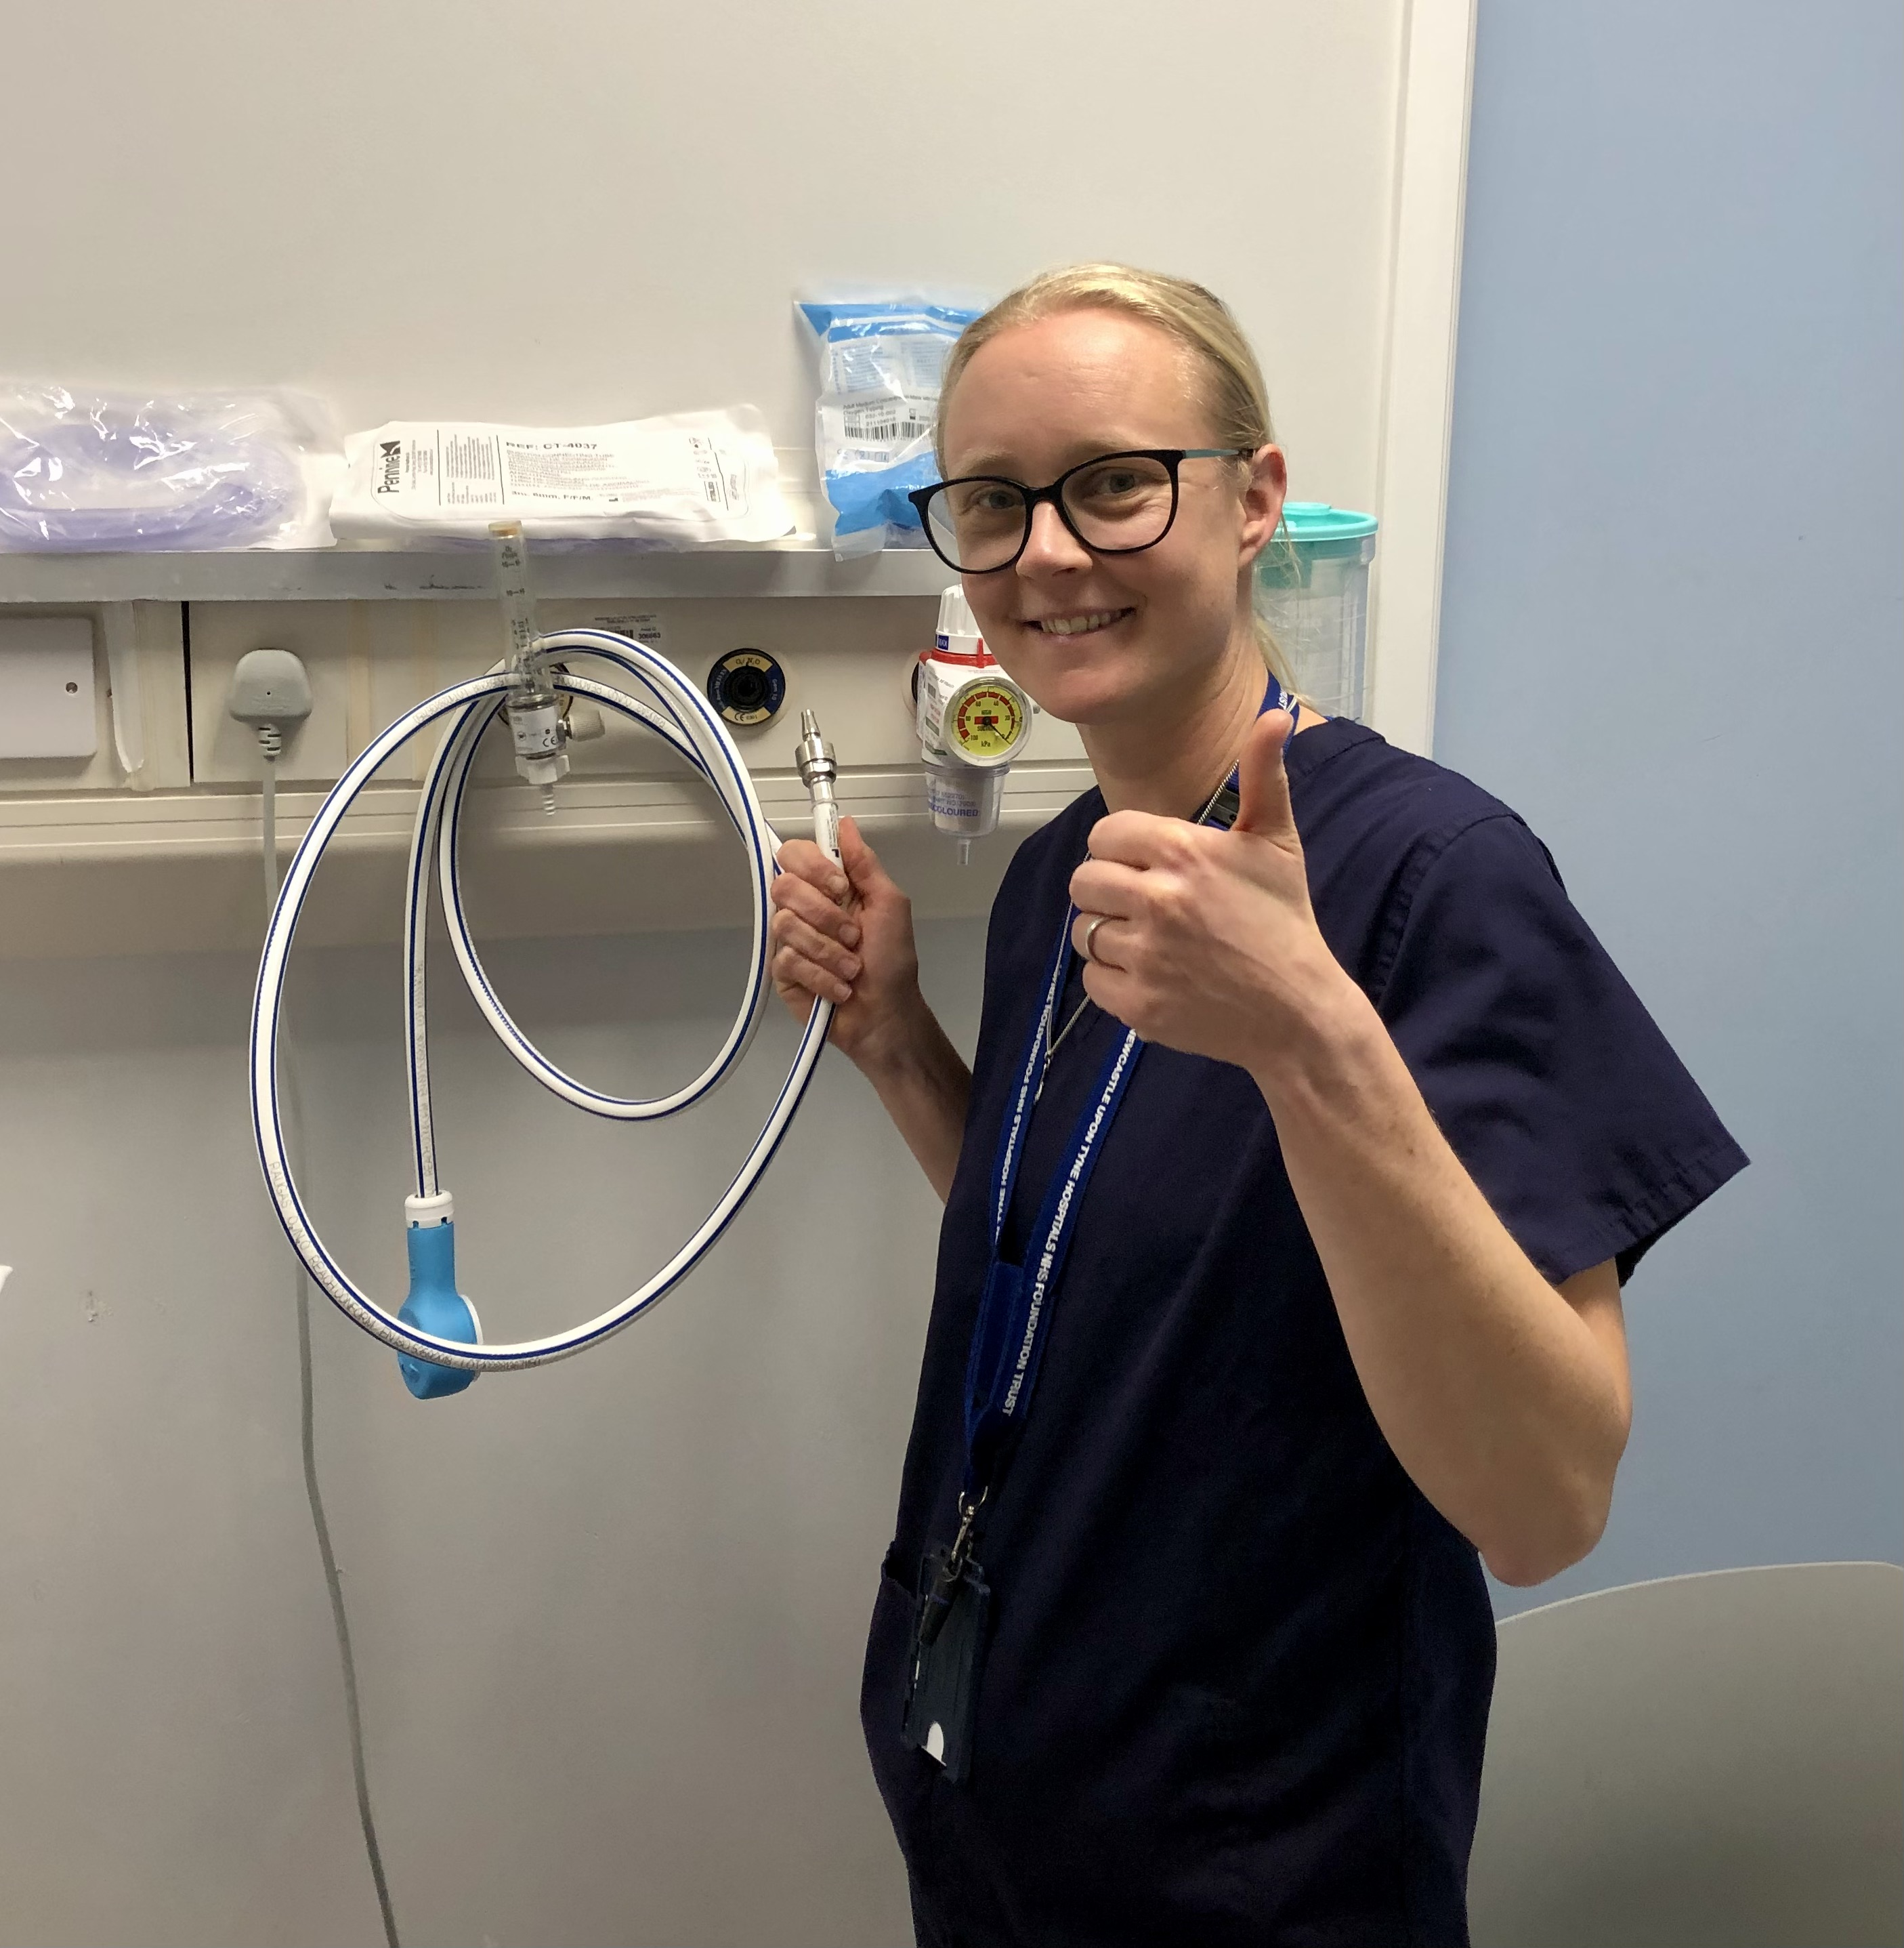
N₂Ovember
Say NO to wasting N₂O
Keeping Entonox plugged in while not in use wastes gas and can be harmful to staff
Please unplug the entonox whilst not in use, save gas, help staff

