Slide 1


SusQI Academy Forum
20th March 2024

Slide 2

Introductions
Updates from CSH
Successes, Challenges, Questions
SusQI Academy network & resources

Slide 3

Green Team competitions and new SusQI case studies
Sheffield Teaching Hospitals (STH) NHS FT, and for the second time, Northampton General Hospital (NGH) NHS Trust in our Green Team Competition programme. The competitions have anticipated annual savings of between £85,712-£252,864 and 34,000-40,172 kgCO2e (equivalent to driving over 100,000 miles in an average car).
New Case Studies from the Green Team Competition | Sustainable Healthcare Networks Hub
We welcome new Academy & Beacon site members
Clair Hinton - Somerset NHS Foundation Trust
Emma Clarke, Mary Pegington, Christopher Hunt, Caroline Felce, Claire Reed - Bradford District Care NHS Foundation Trust
Save the date!
SusQI Showcase – Wednesday 19th June 2024 2pm-4.30pm

Slide 4
The SusQI team will be at the IHI / BMJ International forum - Join 3,000+ improvers at the International Forum London 2024 (bmj.com)
Nursing and midwife sustainability week 18th – 22nd March 2024 NHS England — North East and Yorkshire » Nursing and Midwifery Green Week 2024
CSH NHS England Nursing Insight project
Q exchange project proposals
Medicine Waste in Care Homes: Reducing Social and Environmental Impact | Q Community (health.org.uk)
Our People, Our Planet: an event for our biggest challenge | Q Community (health.org.uk)
Tree equity UK tool Tree Equity - NHS Forest
Green surgery report
The new Green Surgery Report setting the groundwork for reducing the carbon footprint of surgical care
Net Zero Mental Health Care Guidance
Net Zero Mental Health Care Guidance and Education | Royal College of Psychiatrists

Slide 5
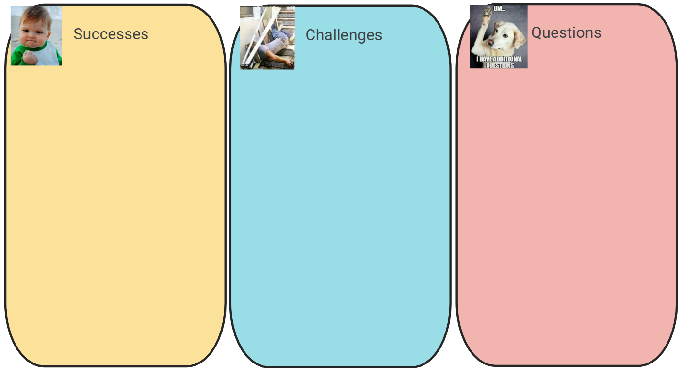
SusQI Academy forum March 2024 - Google Jamboard

Slide 6
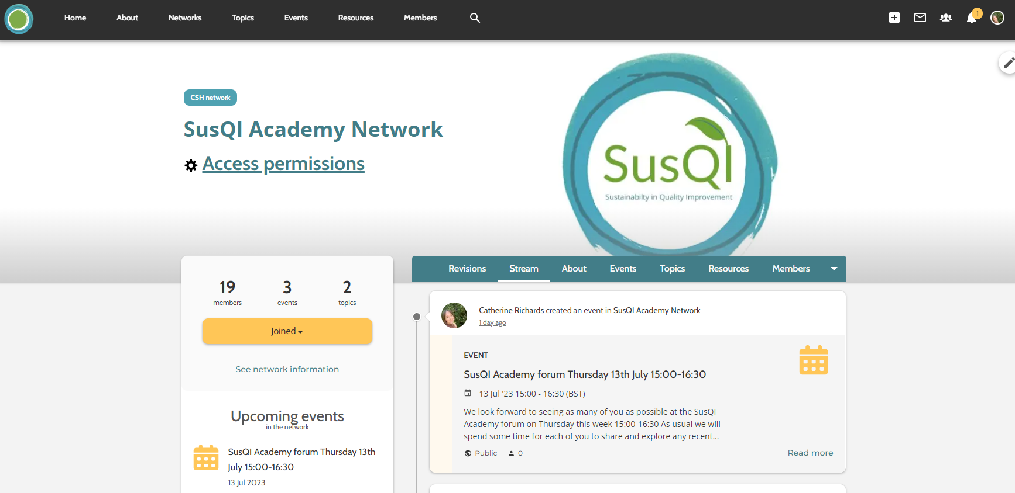
SusQI Academy Network | Sustainable Healthcare Networks Hub

Slide 7

SusQI Academy forum March 2024 - Google Jamboard

Slide 8
Upcoming SusQI, Teaching SusQI and Carbon Footprinting course dates:
SusQI
Workshop: Thursday 18 April 2024 [8.00-12.00 BST]
  Self-study period opens: 21 March 2024
Workshop: Wednesday 22 May 2024 [8.00-12.00 BST]
  Self-study period opens: 24 April 2024
Workshop: Thursday 20 June 2024 [13.00-17.00 BST]
  Self-study period opens: 23 May 2024
  Teaching SusQI
  Workshop: Tuesday 14 May 2024 [8.30-11.00 BST]
  Self-study period opens: 16 April
  Carbon Footprinting
  Workshop: Wednesday 15 May 2024 [8.00-12.00 BST]​
  Self-study period opens: 17 April 2024
  Workshop: Tuesday 18 June 2024 [8.00-12.00 BST]​
  Self-study period opens: 21 May 2024

Slide 9
Course booking
Instructions for you to book yourself on using a voucher code:
Register or Login (if already registered) on https://www.sustainablehealthcarelearning.com
Once logged in click on ‘Book here’
Select your salary band, select your course, select newsletter sign up Y/N
In the Voucher code box enter the following code: ACADEMYCOURSES
Click ‘Book’
You will receive an email with all the instructions required for the course

