Slide 1
DRAGON TRIAL
Dmitri Nepogodiev
Clinical Lecturer in Public Health
University of Birmingham

Slide 2

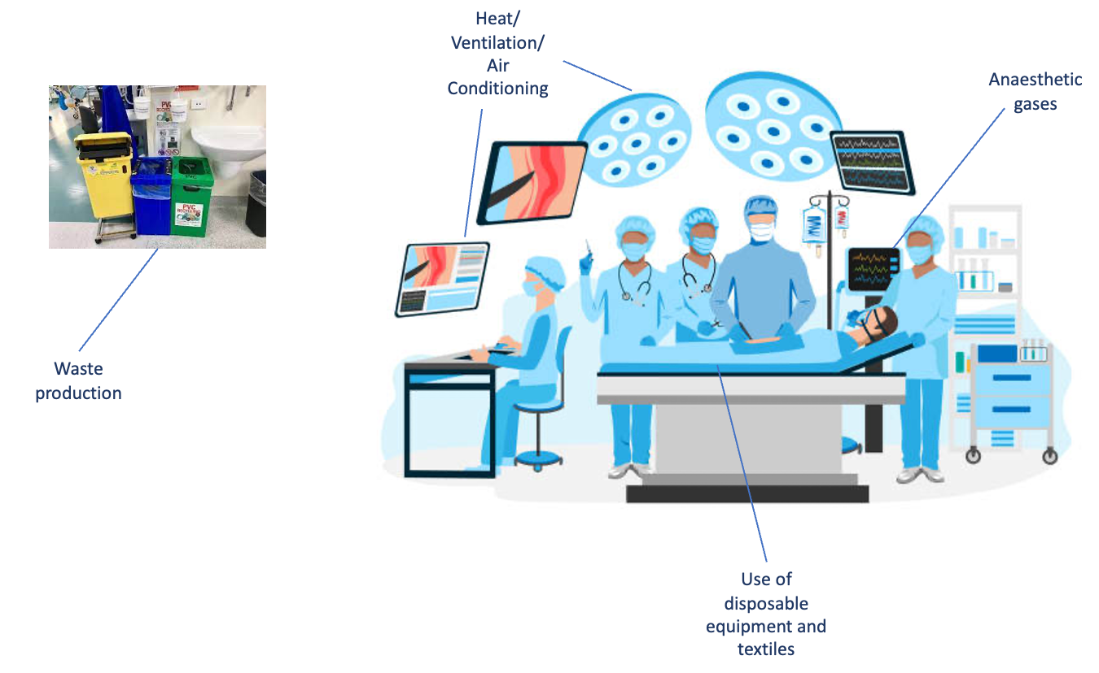
Wider green surgery programme
Background
Starting point
Successful colorectal surgery research group with clinical trials expertise
COVID-19
Developed global pan-specialty surgical network as a research response to the pandemic
Post-pandemic
Aim to leverage network to tackle cross-cutting post-pandemic challenges
Green surgery research programme
Anaesthesia
Initiatives to reduce nitrous oxide
DRAGON
Cluster-randomised trial testing reusable versus single-use theatre drapes and gowns
Progress update
Conference
290 people attended inaugural Research for Greener Surgery Conference in Dec 2023
DRAGON
Protocol submitted to NHS ethics
Modelling
Carbon model completed to evaluate routine glove change (CHEETAH trial)

Slide 3
Reusable drapes and gowns
Both single-use and reusable drapes and gowns are in widespread use globally.
There is no robust evidence to guide choice of single-use versus reusable drapes and gowns.
No World Health Organisation recommendation.
Single-use drapes and gowns may be associated with lower SSI rates, but also likely to have higher financial and carbon costs.
DRAGON trial objectives:
  Determine whether there is difference in SSI with reusable versus disposable drapes & gowns.
  Identify the most sustainable and cost-effective option.
  We will report clinical, cost, carbon outcomes in an integrated results paper (world-first).

Slide 4
A cluster randomised trial
Cluster randomised trials randomise units rather than individual patients.
DRAGON will randomise hospitals to single-use versus re-usable drapes and gowns.
As the intervention is delivered at hospital-level, patient consent is not required for the intervention.
Essential to ensure that all consecutive eligible patients are enrolled and receive the randomised allocation.
  The Intra-operative Case Report Form should be completed for all patients as a check for eligibility.

Slide 5
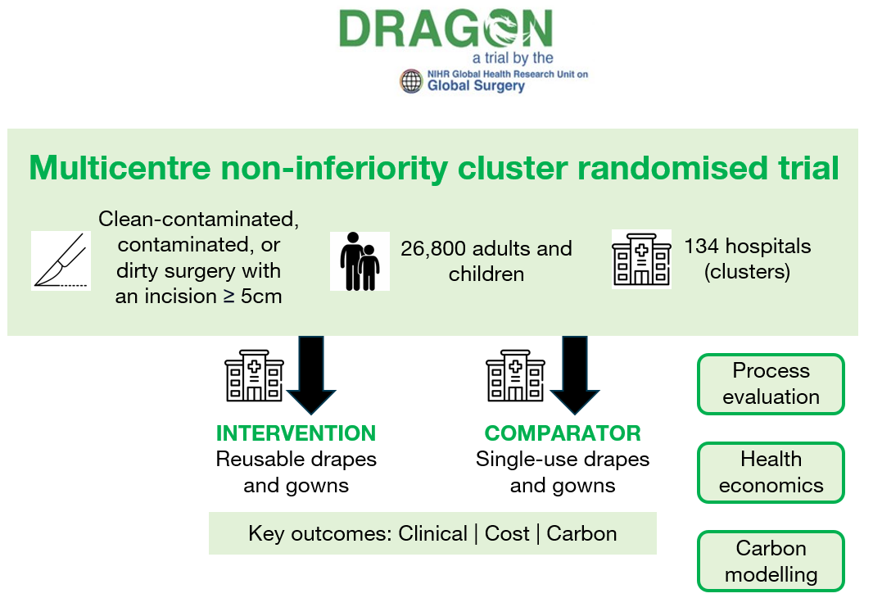
DRAGON methodology

Slide 6
Statistics and trial processes
Sample size:
  12.5% baseline SSI rate with 2.5% non-inferiority margin, 90% power.
  26,800 patients; 134 hospitals (200 patients per hospital).
Streamlined trial processes:
  Waiver for patient consent.
  Two case report forms (intraoperative and 30-day follow-up) only.
  Telephone follow-up.

Slide 7
CLEAN ENERGY IN HEALTHCARE

Slide 8
Energy in the UK
Over half the carbon emissions of NHS hospitals are from building energy use (2,351 ktCO2 annual).
  473 ktCO2 could be reduced by upgrading buildings (e.g. air conditioning, LEDs).
  580 ktCO2 by on-site renewable energy (solar) and heat generation (heat pumps).
  Reducing energy use and decarbonising energy supply are complementary and both necessary.
The NHS signalled its commitment to decarbonising energy by transitioning to purchasing 100% renewable energy from April 2021.
  Renewables accounted for 47.3% of total electricity generation in the UK in 2023.
  Purchasing renewable energy from the national grid does not provide additionality.
UK marginal cost pricing system means that electricity price based on cost of fossil fuels.
  The cost of solar energy generation decreased 92% in 2009-2021
  Solar could reduce NHS energy bills, with savings spent on initiatives for patient benefit.

Slide 9

Living toolkit
Purpose of living toolkit is to share learning from successful schemes to accelerate implementation of clean energy initiatives across the NHS.
  It will contain key documents (standard operating procedures, business plans, etc).
    Toolkit to support public engagement.
  It will be freely available online with documents that can be easily adapted.
  Be updated quickly and efficiently.

