Slide 1
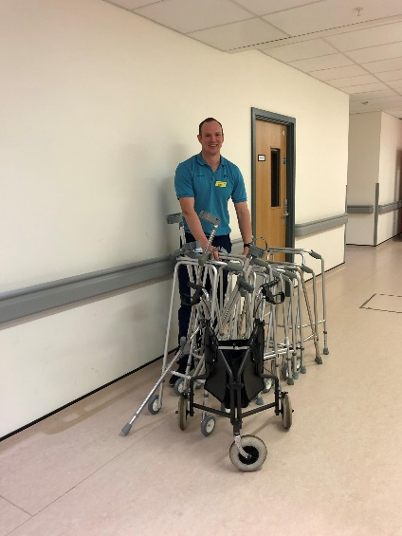
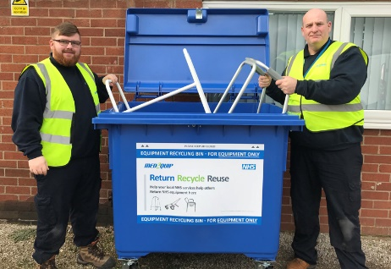
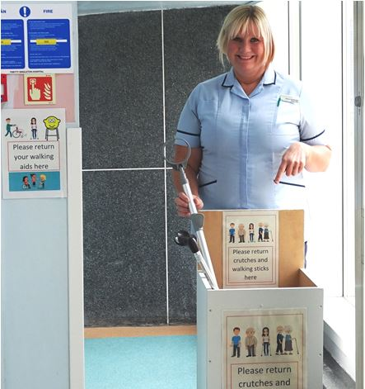
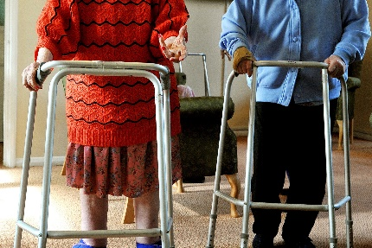
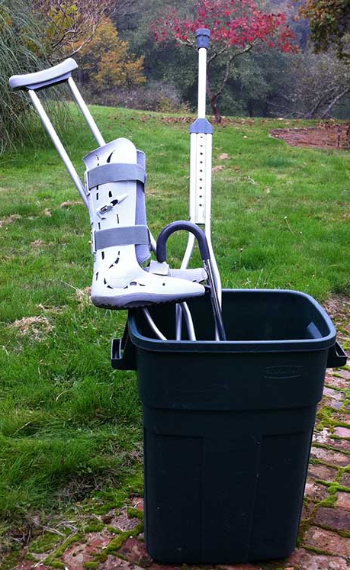
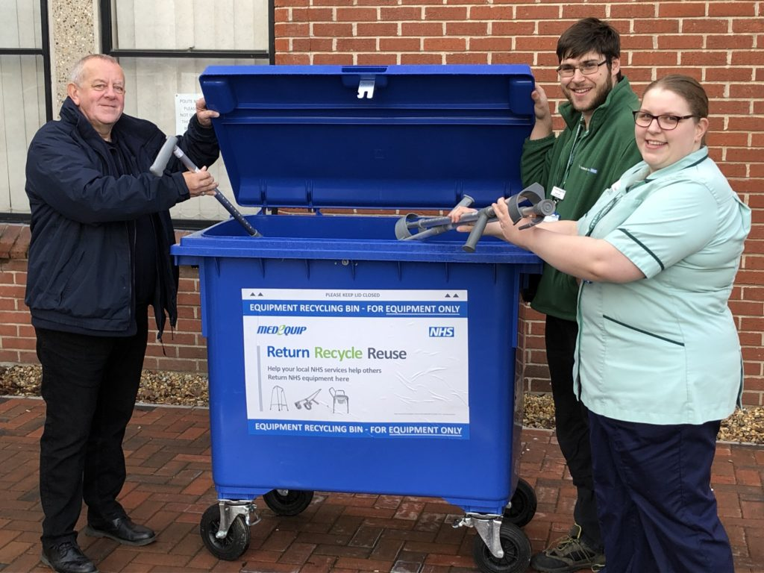
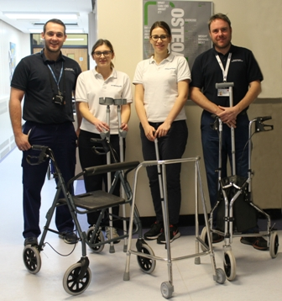

HOW-TO GUIDE
EQUIPMENT RE-USE
WALKING AIDS

Slide 2


The Business Case
Many medical devices (e.g. walking aids) are durable products whose useful life greatly exceeds use by a single patient, and can be refurbished and reused repeatedly, reducing waste to landfill and avoiding carbon associated with new products. Reuse schemes have tended to be limited due to concerns around liabilities, limited resource available to set up a scheme, and the perceived low cost benefit.
Why Reuse
Over the next 3 years the NHS could reduce its carbon emissions by 7.4kt, equivalent to 281,397 car trips from London to Bristol.
Device reuse and refurbishment could save the NHS 202 kt CO₂e or 1.4% of supply chain emissions. Crutches, frames and walking sticks are in the top 20 of medical device / equipment categories for carbon footprint due to the high Green House Gas intensity of aluminium manufacture.
Revenue and savings
Hospitals can save up to £46,000 a year by receiving returned walking aids to be cleaned and refurbished for use by future patients.
Reuse Roadmap
Liability and risk
Walking Aids reuse schemes are low risk for infection control and defects. NHS Resolution's Liabilities to Third Parties Scheme provides indemnity (see slide 9 for more information)
Reuse Portfolio
Case study example
Mid-Essex Hospitals Trust’s achieved a 40% return rate at its pilot site and expanded to a second hospital. 3,000 items worth £27k are reused each year, plus the Trust generates income from scrap metal from damaged items.
Greener NHS ambition
The Net Zero report set a target for 40% reuse of walking aids by 2025, which will contribute to Green Plan delivery for Trusts.
Case Studies
Ease of implementation
Schemes can be in-house taking 5-10 mins to check/clean/repair each item or third-party managed collections, via drop off bins or amnesty campaigns.
Additional Guidance

Slide 3
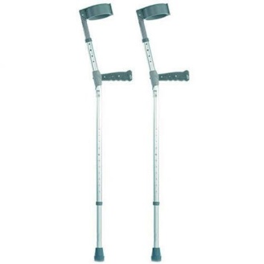
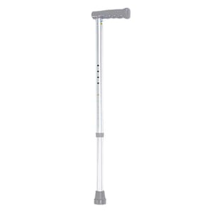
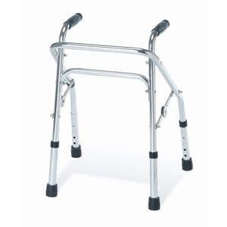
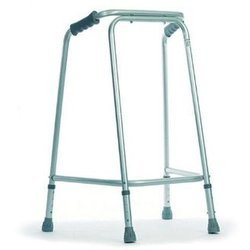
How to set up a walking aid reuse scheme
Walking aid reuse schemes set up a process for items to be returned, cleaned, and assessed prior to being redistributed to a new patient
Why Reuse
Additional Guidance ​
​
Case Studies, legal guidance, example delivery models and standardised project methodology examples are provided in the Additional Guidance section to assist implementation. ​
​
If you need more support, please contact the NHSEI Sustainable Procurement team
england.ccf-sustainability@nhs.net
​
Reuse Roadmap
Consult and investigate
Develop procedures and training
Define returns approach
Allocate resources
Communicate to end users
Crutches
Walking sticks
Walking frames
Reuse Portfolio
Case Studies
Consult stakeholders. Some reuse may already occur. Existing practice provides a baseline and facilitates initial discussions with key stakeholders. | Establish a simple returns approach and locations (hospital, Council recycling centres) via drop off bins or amnesty campaigns. | Use in-house staff to manage inspect, clean and repair; or store and transfer collected items to a third-party provider to manage refurbishment offsite. Provide storage, refurbishment space and collection bins. | Develop Standard Operating Procedures (SOP) for checking, cleaning and repairing items in-house or provision to third-party. Train all staff involved in the movement of items. | Provide simple, clear notice of return locations to end users e.g. equipment labels, and inform patient contact points such as reception, ambulance staff and community nurses.
Additional Guidance

Slide 4
What delivery models exist?
There are several possible delivery models to evaluate as part of your planning process; an individual Trust may deliver a programme locally, an ICS deliver may deliver regionally or you may outsource to a third-party
Why Reuse
Individual Trust
Regional co-ordination
Third-party outsourcing
Programme ownership at individual organisation level with supporting guidance from the centre
(see case study)
Regional co-ordination through ICS community. Options on contracting approach
Outsourced to third party (incl. VCSEs*) with ownership and governance at central level
(see case study)
Reuse Roadmap
Benefits
Understanding of local / regional dependencies and requirements
Items continue to circulate locally
Understanding of local / regional dependencies and requirements
More product circulating in region
Consistent approach for patients and increased drop off locations
Early adopters encourage wider take up
Leverage existing experience within the private sector
Logistics and workforce provided
Established performance reporting system
Reuse Portfolio
More stakeholder engagement required initially
Reduced control and oversight of progress
Potential need for additional logistics set up across region
Reduced control and oversight of progress
Reduced savings
Drawbacks
Lack of Trust engagement could slow down the programme
Multiple programmes across a region may duplicate effort
Case Studies
Additional Guidance
Hybrid Approach: Additional benefits can be realised through the blending of delivery models. For example, a regional ICS co-ordinated approach could engage a third-party to minimise administrative requirements and use existing logistic networks, inventory management systems, cleaning and storage facilities.

Slide 5
Key Stakeholders
A walking aid reuse scheme will establish a solution to return, clean and assess items prior to being redistributed to another patient
Why Reuse
Reuse Roadmap
Clinicians, Physiotherapists, Occupational Therapists, A&E | Sustainability & Procurement managers | Peripheral Stores, Porters, Waste Teams | End User Contact Points
Teams whose budgets are affected. Staff that issue patients with equipment and need to support approaches to equipment tracking, and assurance of appropriate procedures for quality control. | A Walking Aid reuse scheme can support broader sustainability programme ambitions. Establish a third-party collection contract (NHSSC Aids to Daily Living Lot 36) or community equipment contracts may be available through Local Authority Social Care teams. | Staff involved in stock management, ordering, storage and transfer (and reuse activity for inhouse schemes). Joint development of procedures and training. | Reception – contact points for general patient queries Ambulance – abandoned patient equipment Community Nurses – patient visits Care Homes – long-term users, including higher cost items
Reuse Portfolio
Case Studies
Additional Guidance

Slide 6
Additional Guidance
Case studies
Liability and risk assessment
Delivery models
Project methodology examples

Slide 7
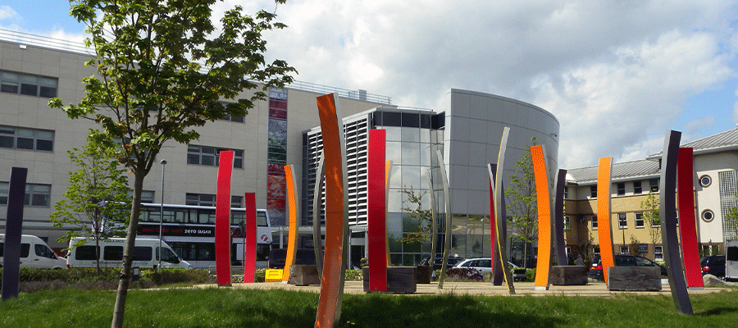
In-house reuse programme
Mid Essex Hospital Trust achieved a 40% return rate through its Walking Aids reuse programme, which involves staff inspecting, cleaning and repairing equipment onsite, saving around £25,000.
Why Reuse
Organisation
Mid and South Essex NHS Foundation Hospital Trust
Issue
Broomfield hospital with over 800 beds and over 6,000 employees treats a variety of injuries and conditions. In a year they spent £60K on walking aids (£24K on walking frames and £36K on crutches), mainly issued through the Therapies Department, who established and coordinated the reuse scheme.
Reuse Roadmap
Action
An equipment return area was established in reception, staff then transfer items to a designated room for cleaning and assessment. A member of staff pairs, inspects them for functionality and faults, cleans them following local agreed SOP, and replaces worn feet bungs. Any walking aids that fail the checks are treated as waste and allocated for metal recycling.
Reuse Portfolio
Impact
Around 40 walking aids are reused each week
21% of crutches and 61% of frames are returned
Reusing more than 3,000 pieces of equipment and saving around £27,000 per year
The refurbishment process is quick and easy, taking one person around 5-10 minutes per walking aid.
Case Studies
Lessons learned
The reuse scheme needs a clear owner and coordinator
A dedicated room is needed to inspect and recondition equipment along with a member of staff supporting this work ~5 hrs/wk (it is not a resource intensive activity)
A set and agreed procedures to follow simplifies the task and ensures appropriate checks are completed.
Communicating a simple returns approach to patients is important for success (the team used labels on equipment to encourage patients to return items)
Additional Guidance

Slide 8
Third-Party Outsourcing
Third-party equipment providers can collect and prepare items for reuse, with many Trusts using them to manage reuse schemes, providing waste and carbon reductions and financial savings.
Why Reuse
Organisation
Medequip
Issue
Medequip works with local councils and commissioning groups across the UK, supplying equipment ranging from simple walking aids through to sophisticated bed packages. Health authorities and councils spend some £207m in a year on Community Equipment Services. Around 2 million of the 3.5 million items loaned to patients are returned.
Reuse Roadmap
National Association of Equipment Providers (NAEP)
NAEP is a membership body that supports equipment providers and equipment services. They can provide details of suppliers offering services.
See more information on NAEP here.
Action
Medequip collects loaned equipment from designated addresses using 'dual capacity' vehicles, with separate doors and areas for clean and dirty items and antibacterial linings, maximising logistics capabilities and reducing journey numbers. Each item has a unique barcode to track it across the system, manage stock in line with anticipated requirements and providing the customer with returns data. Used equipment is assessed and prepared for reuse, or recycling and salvage of spares where the whole item cannot be reused.
Reuse Portfolio
Case Studies
Impact
Medequip developed its ’Return, Reuse, Recycle’ campaign in partnership with West Suffolk NHS Trust, increasing rates of return significantly and rolling the approach out in other areas. Some 77% of West Suffolk's equipment is successfully returned – (higher than the 55% national average) of which 91% is reused. More detail on the Medequip process can be found here.
Additional Guidance
Lessons learned
The general public need to be made aware of the importance of returning these items.
It needs to be easy to arrange a collection and equipment return locations need to be easily accessible.

Slide 9
Liability and risk assessment
Liability for defects can arise for manufacturers, importers or Trusts. The risk for a walking aid reuse scheme is low and should not be a barrier to implementing a scheme when balanced against the significant environmental, health and cost benefits savings.
Why Reuse
Liability depends on specific circumstances…
Trusts can mitigate the risk by...
Potential Liabilities
Strict Product Liability: The Consumer Protection Act 1987 (CPA), liability for damage caused by a defective product.
Negligence: A claimant who has suffered personal injury as a result of a defect may bring a common law action for negligence against the manufacturer and/or the Trust.
Contracts: may manage the liability between the parties and indemnify each other against potential liabilities.
Regulatory: Product safety is regulated and can result in legal action. In most cases the Medical Devices Regulations 2002 (MDR) will apply to Walking Aids. The General Product Safety Regulations 2005 (GPSR) may apply more broadly to products intended for consumer use.
Is the aid authorised for reuse? Have any conditions and instructions for re-use, maintenance and/or repair been followed?
Only issue devices intended for reuse (NHS Supply catalogue crutches: NHS SC - GTB1817)
Implement a quality and safety assurance programme with procedures to safely inspect, recondition, repair (minor) and set limits of reuse
Reuse Roadmap
Ensure indemnity/insurance is in place e.g. NHS Resolution's Liabilities to Third Parties Scheme, contact generalenquiries@resolution.nhs.uk
Avoid being seen as a producer of the walking aids by only reusing aids that require minor reconditioning, and avoid ‘white label’ partnerships
Maintain an inventory of manufacturers/suppliers of aids issued, a log of inspections, reconditioning, repairs and re-issue
Did the defect arise through manufacture or supply to the Trust, or did it arise through the reconditioning/repair process?
Reuse Portfolio
Case Studies
Ensure the patient is provided with sufficient information, guidance and support on safe use and risks arising from use
If a patient is injured, establish whether the patient’s own negligence (e.g. inappropriate use) or voluntary assumption of risk (e.g. Risks known to the patient) contributed to the injury.
Provide and record written guidance and instruction/ demonstration given to patients on the safe use of walking aids and reporting and dealing with any issues.
Report any adverse incidents to MHRA Yellow Card
Additional Guidance
NHS Resolution have stated a Trust/ICS with appropriate indemnity insurance will be covered for a walking aid re-use scheme.

Slide 10

Delivery models | Walking Aid amnesties
A walking aid amnesty is a useful starting point in establishing reuse and can be used to test capability and processes, particularly for an in-house reuse programme in your Trust/ICS.
Why Reuse
What is a walking aid amnesty?
A one-off or periodic campaign to encourage patients to return items after use. An amnesty allows any patient, their relatives or friends to return items that are no longer used. They can then be inspected and refurbished as needed and made available for re-issue to patients.
West Suffolk NHS Foundation Trust's amnesty campaign resulted in 8,500 items worth around £800,000 returned. More information can be found here.
Walking aid amnesty at QEH
The Queen Elizabeth Hospital King’s Lynn ran an amnesty on walking aid equipment to recover items such as crutches and walking frames.
Rehabilitation Services Manager Nigel Tarratt said: “When patients are discharged from hospital they are often given items of equipment to help with their recovery. This could be something straightforward such as a walking aid or crutches.
“If patients and their families fail to return the equipment when it is no longer needed we do our best to recover it. Very often it cannot be found because it has been put away out of sight.”
A drop-off point was set up in the Rehabilitation entrance at the hospital to enable easy returns. More information can be found here.
Reuse Roadmap
Reuse Portfolio
Where to start
Identify potential partners: Understand whether there are any local suppliers or equipment providers with whom you might wish to partner to support collection and storage of mobility aids
Set up logistics / infrastructure: Purchase cage / bins for collecting items and decide where to locate them. For example, George Eliot Hospital Trust set up an amnesty cage outside the hospital’s Rehabilitation Entrance so people did not have to enter the hospital to reduce the risk of COVID-19 transmission .
Standard Operating Procedure (SOP) for cleaning and assessment: Set up an SOP for infection control prevention
Case Studies
Additional Guidance
Refer to MHRA Guidance on managing medical devices and the approach to maintenance, repair and decontamination to determine the best delivery model for your Trust/ICS

Slide 11
Delivery models | In-house Model
An inhouse model can be more cost effective, using quick and simple refurbishment processes that follow a Standard Operating Procedure agreed locally with clinicians and therapists.
Why Reuse
What does an inhouse approach involve?
An in-house approach uses internal staff and facilities to complete all aspects of the refurbishment process, from inspection, cleaning and completing minor repairs, to tracking, monitoring, collection, storage and movement of items. The process is simple and quick, taking 5 – 10 minutes per item.
Lessons Learned
Establish a clear owner and coordinator for the programme
Allocate a room for the reconditioning to be carried out and a member of staff to support this (it is not a resource intensive activity)
Set and agree processes (SOP) to follow
Communicate with users (i.e. add stickers to encourage the return of devices)
Equipment tracking needs to be quick and simple to encourage participation by time pressurised teams
Focus on ease of implementation by staff and improving returns over tracking individual items
Performance data can be provided by third party providers.
Reuse Roadmap
Where to start
Identify programme owner: The programme owner will provide project sponsorship
Set up refurbishment room: Establish a dedicated area with sufficient space for inspecting, cleaning and repairing items, and storage space to clearly separate dirty returned items and clean items ready for reissue.
SOP for cleaning and assessment: Set up a standard operating procedure (SOP) that includes infection prevention control, documented approval for products to be used and an escalation process.
Order supporting equipment: storage cages or bins for collection, replacement parts, labels to mark equipment as 'on loan' and identify returns location or contact, any other communication materials and disinfecting cleaning products.
Measuring progress: Agree a standard set of KPIs and establish monitoring processes for measuring progress. See the monitoring and reporting examples.
Staff Training: Train all staff in infection control, and portering staff in the process
Reuse Portfolio
Case Studies
Additional Guidance

Slide 12

Delivery models | Third party enabled solution
An outsourced model reduces administrative requirements for the Trust/ICS and provides wider access to patients looking to return items. Schemes that do not return items to the Trust/ICS for re-issues may not deliver savings to the Trust/ICS.
Why Reuse
A third party enabled solution provides experience of rolling out a reuse programme. The solution might include:
Fully outsourced model to third party: Engage with a third party who provide a managed service for community equipment. If unsure where to start, The National Association of Equipment Providers (NAEP) is a membership body for providers of equipment and services.
Use of VCSE*, providing a level of social value: Explore whether any local VCSE organisations provide take back or reuse services, for example British Red Cross
Collaboration across the region with third party (private sector or VCSE): Blended model harnessing the benefits of Regional / ICS delivery and Third party enabled delivery
Where to start
Identify potential partners: Understand existing contracts and relationships through SCCL or your local area, as well as potential other third parties who might be suitable to partner with
SOP for cleaning and assessment: Work with the third party to set up a SOP for your programme that follows local IPC and decontamination policy. They might already have standard procedures from similar schemes
Measuring progress: Agree a standard set of KPIs and process for measuring progress. See the monitoring and reporting examples.
VCSE take back schemes
There are a number of voluntary, community and social enterprise organisations who provide take back schemes, both locally and nationally.
For example, Warrington Disability Partnership runs a mobility equipment recycling scheme.
The scheme recovers, recycles and reuses electric mobility scooters and wheelchairs, manual wheelchairs, crutches, wheeled and framed walkers. Donated equipment, once restored, is used in their Shopmobility fleet and independent living equipment loan services. Surplus goods are sold on at affordable prices from their Shopmobility service.
Reuse Roadmap
Reuse Portfolio
Case Studies
Additional Guidance

Slide 13
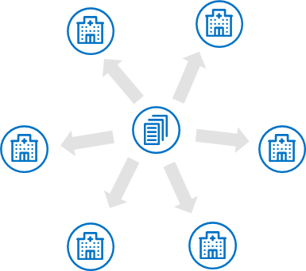
Delivery models | ICS/Regional Co-ordination
Aggregating contracts or procurement approaches from across your ICS/region could enhance the benefits of your programme
Why Reuse
Regions can have a variety of separate contracts and logistics operations for walking aids with a mix of in-house operations and outsourced. Fragmented service delivery is likely to incur higher costs than delivery at scale. Warehousing, cleaning, monitoring systems and other support contracts could be consolidated under a regional model.
A regional model would provide a consistent service for users through a consolidated operating platform.
Regional models | Description | Benefits | Drawbacks
Common platform across in-house providers | Implement a central procurement function and single IT system across the non-outsourced providers No change to outsourced contracts | Lower one off and recurring costs Short time to deliver (est. 3-6 months) | Limited regional collaboration
Consolidated operating model with in-house providers | Integrated model across the non-outsourced providers delivered by one service provider No change to outsourced contracts | Potential for high recurring and one-off benefits | Longer time to deliver (est. 14-17 months) Lower net benefit compared to #3 Limited regional collaboration
Single consolidated operating model across the region | Fully integrated single operating model across the region delivered by one service provider | Potential for high recurring and one-off benefits Full regional collaboration | Longer time to deliver (est. 17 – 20 months)
Reuse Roadmap
Reuse Portfolio
Case Studies
Additional Guidance

Slide 14
Examples | Workflow map
Why Reuse
PATIENT CARE
RETURN & RECOLLECTION
CLEAN & RESTOCK
HIGH-LEVEL DESCRIPTION
Patient receives a walking aid device to be used while patient remains on the ward
…
…
…
…
…
Patient is assessed for need of walking aid following discharge
Ward equipment is returned, and ‘take-home’ walking aid ordered for patient
Reuse Roadmap
THERAPIST
PATIENTS
WARD
EQUIPMENT PROVIDER
Identifies the patient needs a walking aid: walking stick, elbow crutch, zimmer frame, or rollator frame
Patient assessed for on-going need of walking aid. Where the patient requires an aid following discharge, the therapy team orders equipment for discharge from the equipment service provided by the relevant local authority
Does the equipment provider collect sub-stores equipment i.e. equipment not delivered?
Reuse Portfolio
Stock not collected or returned assumed to be disposed of (i.e. waste)
Receives equipment from the ward. Where possible, relatives were previously encouraged to bring the patient’s own aid to the ward, but with visiting restrictions and increased IPC guidelines this has not happened for the past 12 months)
Receives walking aid from equipment provider or, if discharge imminent, provided by the ward sub-stores
Provided with telephone number and advised to contact equipment provider to arrange collection.
Case Studies
Walking aid provided from ward stock.
How is this ward stock managed?
Who is responsible for it?
Who is responsible for the sub-store stock?
Walking aid provided from sub-stores
Ward equipment returned
Walking aid checked for damage, general wear and tear. If none, cleaned with soapy water/ low level disinfectant and re-stocked
Additional Guidance
Does the equipment provider replenish sub-stores stock?
Replenish ward sub-stores
Deliver walking aid to patient’s home address
Collects equipment from Patient
What happens to this equipment?
What happens to returned ward equipment from in-patients?
What quality control checks are in place?

Slide 15
Examples | Roles & responsibilities*
Define required roles and responsibilities within the Trust/ICS and at a committee level, including oversight of procedural documents, compliance with decontamination guidance and cleaning standards audit results
Why Reuse
ROLE | RESPONSIBILITIES
Chief Executive | Overall responsibility for ensuring the Trust has robust and up to date procedural documents in place to govern and guide activities
Executive Directors | Ensure all procedural documents under their remit are appropriate, up to date and available at the point of need
Director of Nursing | Overseeing progress on all procedural documents and reviewing and taking action where appropriate in relation to updates received from the procedural document group.
Musculoskeletal (MSK) Directorate Committee Meeting | Ensure their procedural documents are reviewed in a timely manner.
Musculoskeletal (MSK) Managers | Support the dissemination and implementation of new / revised procedural documents.
All Musculoskeletal (MSK) Staff | Responsible for familiarising themselves with this procedural document and co-operating with the development and implementation of all procedural documents as part of their normal duties and responsibilities.
All Staff | All staff have a duty to maintain a clean environment. Those assisting with walking aid cleans must follow the provided flowchart.
Musculoskeletal (MSK) Clinical Governance: | Ensure procedural documents are updated and reviewed within the required timeline.
Author | Lead on the development or major review of a procedural document. The author must also provide a brief summary for staff communication / launching purposes. All procedural documents must have an equality impact assessment.
Reuse Roadmap
Reuse Portfolio
Case Studies
Additional Guidance
*Example from Mid-Essex Hospital Trust

Slide 16
Examples | Cleaning and checking procedure
Below is a basic example cleaning and checking procedure based on case studies and supplier guidance of ‘not for single use’ aids
Why Reuse
Returns moved to storage
Assess extension
Assess item for stress
Assess grips
Assess wheels, screws, springs
Returned walking aids moved to cleaning and assessment room. Assess crutches as a pair.
Fully extend the aid to reveal the whole shaft, test all buttoned extensions for easy adjustment
Visual check for wear, damage, rust, stress or cracks. Apply weight and twist the frame to check rigidity and strength
Assess for deformed, worn, torn or missing grips, handles or pads. Apply weight to test stability and tightness of grips/handles
Assess any wheels for cracks. Conduct tests for ease of wheel rotation, brakes lock and unlock, screws/bolts are tight, adjusting springs move easily and fixings are secured
Reuse Roadmap
Aid issued to patient for reuse
Pass
Fail
Reuse Portfolio
All checks passed. Walking aid is suitable for re-use.
One or more checks failed, place aid in the metal recycling collection area. If one crutch fails, dispose of as a pair. Record failed items.
Case Studies
Record the result and return to stock
Replace parts and label
Clean items
Record walking aids passed for re-issue and cleaned to a designated re-issue area
Check ferrules and fixings. Replace worn parts or that are not secure or flush to the floor. Add a new returns label (centre of frame rail or shaft of crutch).
Clean the whole extended shaft and handles and use a suitable low-level disinfectant.
Additional Guidance

Slide 17
Examples | Training requirements
Create SOP for assessing items and the decontamination process and training materials that address the technical skills and knowledge requirements
Why Reuse
  Training Requirements
  Infection prevention control learning - mandatory for all staff
  Process and criteria training for new portering staff
  Infection prevention control
  Walking aids are low risk – commonly coming into contact with intact healthy skin and are non-clinical in nature.
  A reusable cloth (where validated laundry process is available) or wipes for cleaning to remove organic matter and the use of a low-level disinfectant suitable for the equipment according to local trust IPC and decontamination policy is considered a suitable decontamination method. Refer to the National Standards of Healthcare Cleanliness 2021 and your local Infection Prevention Control lead for further guidance.
Reuse Roadmap
Reuse Portfolio
Category | Indication | Examples | Level of Decontamination | Method
Low Risk | Items used on intact skin | Washbowls, mattresses | clean | Wash with warm water and neutral detergent and dry thoroughly or use reusable cloth and suitable low-level disinfectant (following manufacturers guidance on compatibility, contact and drying times)
Case Studies
Additional Guidance

Slide 18
Examples | Monitoring and reporting
Collecting and periodically analysing data from the programme is vital in order to understand success and areas for improvement
Why Reuse
A log sheet and accompanying spreadsheet should be used to measure and track the volume of walking aids returned and reused as well as the accompanying financial benefits. The data should be monitored and evaluated periodically in order to identify opportunities for further improvement. The log sheet should look to include information on items returned, refurbished and disposed, as well as monitor any replacement parts and their stock levels. For example:
This log sheet can then be used to monitor the percentage of items refurbished, volume of waste avoided and carbon savings. Other example success measures include:
Date
Crutches returned (pairs)
Crutches refurbished (pairs)
Crutches disposed of (pairs)
[Other items] returned (pairs)
[Other items] refurbished (pairs)
[Other items] disposed of (pairs)
Number of ferrules used (single)
Reuse Roadmap
Total saved on walking aids (per category)
% return rate of walking aids
Refurbishment time
Patient satisfaction with refurbished walking aid
Reuse Portfolio
Measuring carbon and waste impact
Collecting the right data will enable you to calculate your impact on cost, waste and carbon.
Example metrics:
Total savings from refurbished items: Cost savings from not needing to repurchase items
Carbon savings from refurbished items: kgCO₂e diverted by not needing to repurchase items
% Refurbished instead of disposed of: Ratio of returned items refurbished versus disposed of (due to wear and tear)
Waste collections saved: Average waste collections per tonne multiplied by total weight refurbished
Waste savings per tonne: Cost per tonne multiplied by volume avoided
Case Studies
Additional Guidance

