Slide 1
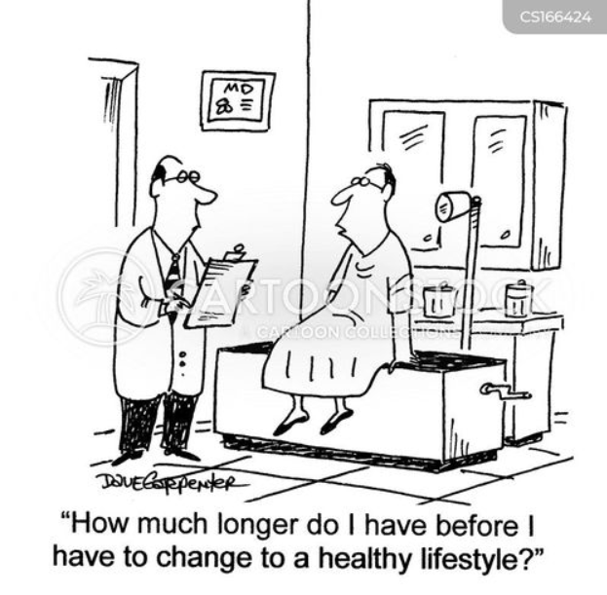
Healthier You, Healthier Plant A lifestyle approach to Health
How to help those
with the most need and
look after the planet
Dr Caroline Butler
GP MMP, Metabolic Health Coach

Slide 2
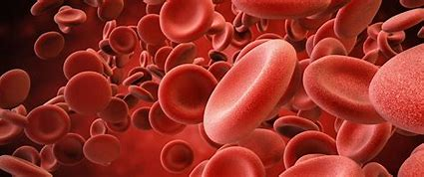
Dr Caroline Butler

Slide 3
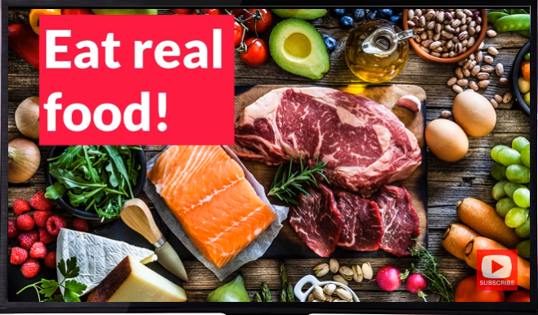
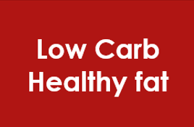
Mythe Low Carb Club Lower Carb & Healthy Fat Lifestyle approach
Eat REAL FOOD
Minimise sugar
Concentrate on quality of carbs
Make sure you eat enough protein
Don’t fear natural fat
Connecting with your ‘why’
Movement
Sleep
Relaxation
Connection & Support
Notes:
What we are going to focus on over the next few weeks is how to tweak your lifestyles to a lower carbohydrate, healthy fat approach to diet by minimising the sugars and carbs in our food by opting to eat real food where possible, take in a moderate amount of protein and whilst not fearing natural fats. We will be looking in detail today about why that matters and what benefits uyou might see when taking this approach and this week I’d like to spend a bit of time working out where your issues with food might lie and give you a focus on the weeks ahead of how to solve them.

Slide 4
Aims & Objectives
The Global Syndemic - why management of obesity matters to the planet's health
Lifestyle medicine – what is it and why does it matter?
What is metabolic health?
Lifestyle approach to metabolic health
Practical tips for behaviour change
Useful resources & CPD

Slide 5
Malnutrition is the single greatest case of ill-health and premature death globally
The Global Syndemic | STOP Obesity Alliance | Milken Institute School of Public Health | The George Washington University (gwu.edu)
Notes:
Malnutrition in all its forms, including undernutrition and obesity, is the single greatest cause of ill-health and premature death globally, and its already devastating impact on global health is expected to be further exacerbated by climate change.

Slide 6
https://garmaonhealth.com/metabolic-syndrome-affects-us-population/
Notes:
So if we keep supplying too much sugar to our bodies, we develop insulin resistance which is at the core of a group of conditions known as the metabolic syndrome. All these problems are potential outcomes – heart disease and stroke, high cholesterol, high blood pressure, diabetes, dementia, at least 8 times of cancer, polycystic ovary syndrome and fatty liver disease. All these conditions are on the
Diagnose if 3 of the 5 criteria are met:
Raised waist circumference – More or equal to 94cm for men (90cm for non-European men), more or equal to 80cm for women
Raised Triglycerides – More than 1.7mmol/L
Reduced HDL cholesterol – Men < 1.03mmol/L, Women < 1.29mmol/L
Raised blood pressure – More or equal to 130/85 (or on antihypertensives)
Raised fasting glucose - More or equal to 5.6mmol/L
Metabolic Syndrome is underpinned by Hyperinsulinaemia and Insulin Resistance.
Many diseases of Insulin Resistance including diabetes, prediabetes, non alcoholic fatty liver disease, PCOS, cancer, dementia, arthritis, gout, depression, CKD…
In practice, we rarely measure TGs and waist circumference – perhaps we should?
increase but the great is, if we can take control of our metabolism by fuelling it with the right kind of foods, we can stop this being our future.

Slide 8
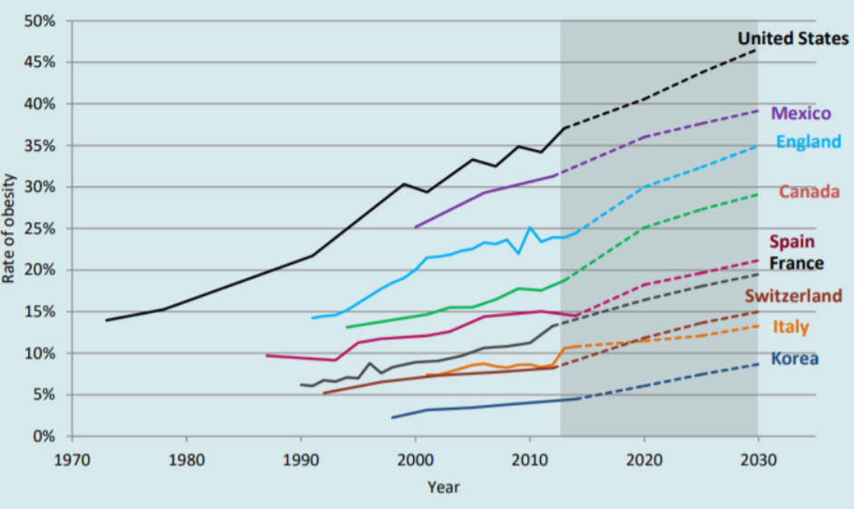
Worldwide obesity rate
Optimizing Our Food System for Nutrients Over Calories (rockefellerfoundation.org)
Notes:
Increasing in every corner of the globe
The global increase in obesity is a visible marker of serious systemic problems with contemporary food systems, living environments, and social equity.

Slide 9
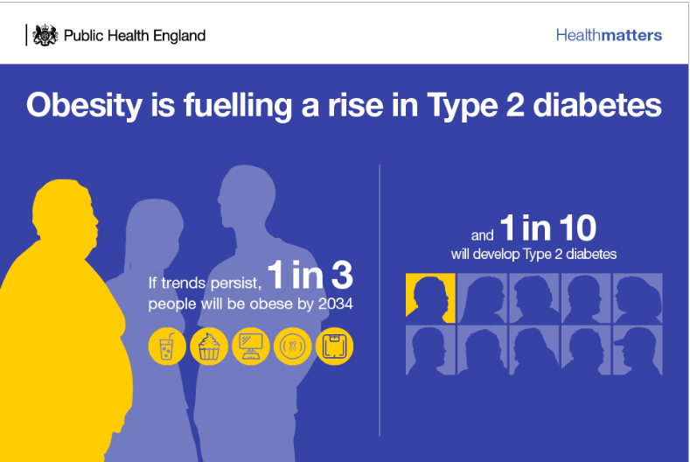
Notes:
Approx 8% ok UK adults have Type 2 Diabetes
Type 2 Diabetes rate doubled in last 15 years

Slide 10
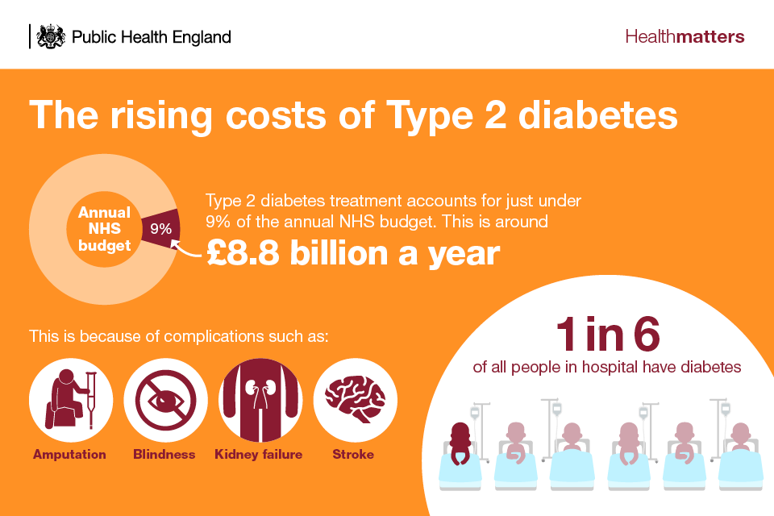

Slide 11
Notes:
Life expectancy stalled since 2011
Approx 11.7 unhealthy last years
Health gap between richest and poorest has increased in the last 10 years – 10 years for men and 8.5 years for women
Health crisis of non communicable disease
Medication is a sticking plaster and distract us from getting to the route of the problem
Most people know what ‘healthy is’ but don’t achieve it
We feel we have far too little time to do this alone

Slide 12
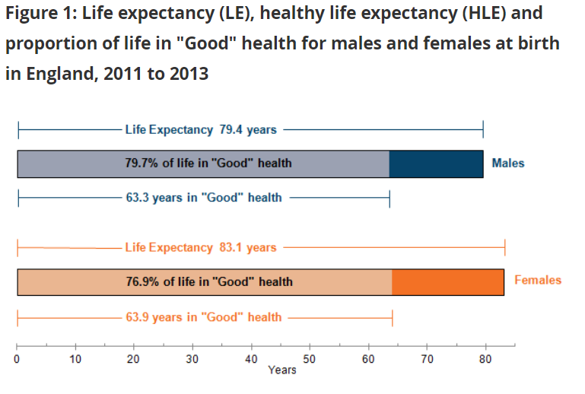
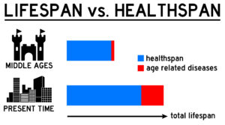
Lifespan vs Healthspan: The Science of Aging Part 1 - Ames Medical Services

Slide 13
Notes:
Syndemic is a term originally used to describe the interactions between two or more diseases at the individual level, which co-occur in time and place, and share common underlying drivers.
This report definitively place and critically examine obesity in a wider context of the global interactions of the pandemics of obesity, undernutrition, and climate change. Because these three pandemics are driven by the food, land use, transport, and urban design systems, they may also share common solutions.
The links between the pandemics of obesity, undernutrition and climate change constitute The Global Syndemic – they interact in time and place, adversely affect each other, and have common social, economic, or environmental determinants.

Slide 14
The Global Syndemic | STOP Obesity Alliance | Milken Institute School of Public Health | The George Washington University (gwu.edu)
Notes:
Because these three pandemics are driven by the food, land use, transport, and urban design systems, they may also share common solutions. So how do they inter play
With climate change, increasing ambient temperatures and precipitations could contribute to a higher obesity rate due to reductions in physical activity.
Climate change will increase undernutrition through increased food insecurity from extreme weather events, such as droughts, and changes in the nutrient content of foods.
As an example, climate changes in Tigrai, Ethiopia, increased the average price of tomatoes by 310% between 2009 and 2015. Climate change will potentially increasing consumption of energy-dense, nutrient-poor processed foods that contribute to obesity.
3) Food production accounts for almost 30% of all greenhouse gas emissions, half of which come from cattle, and beef consumption contributes to colon cancer, cardiovascular disease and obesity. Obesity is associated with ~20% more Greenghouse gas emissions than the average person’s footprint, of which 52% comes from food and drink consumption - approx 30% more calories to maintain body weight - The total impact of obesity on climate change may be an extra 700 megatons per year of CO2eq emissions.
4) Meeting the demands of an increasing population of obesity puts extra pressure on the climate for example through red meat production well known source for GHGEs, particularly methane and nitrous oxide from enteric fermentation, manure and fertilisation. The problem may be that consumption per capita has also increased from 20kg to 43kg per person per year from 1961 to 2014. Bearing in mind livestock uses approximately 70% of global agricultural land and is a prime driver of deforestation, matching increasing demand with increased production could have terrible consequences.
5) Likewise, fetal and infant undernutrition increase the risk of adult obesity.

Slide 15
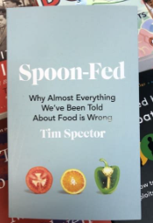
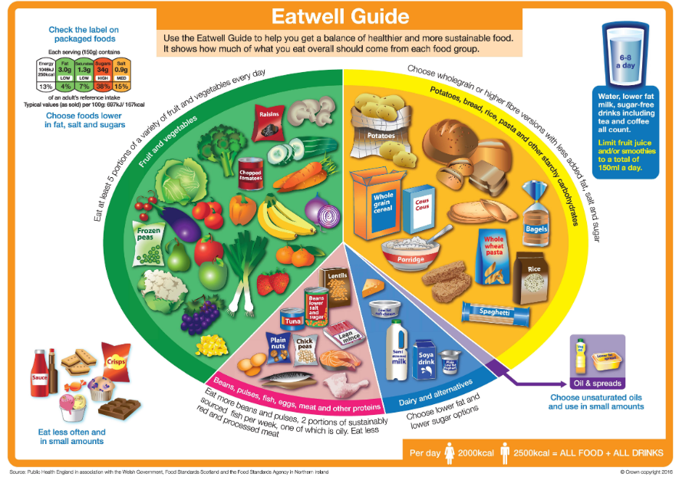
Current ‘health’ advice
2000 calories/day for women, 2500 calories/day for men
Eat less, move more
10,000 steps a day
1 mile a day for children
Low fat diet
5 fruit & veg a day
Eatwell guide

Slide 16
Lifestyle Medicine
Lifestyle Medicine - A Modern Medical Discipline Transforming Healthcare - YouTube

Slide 17
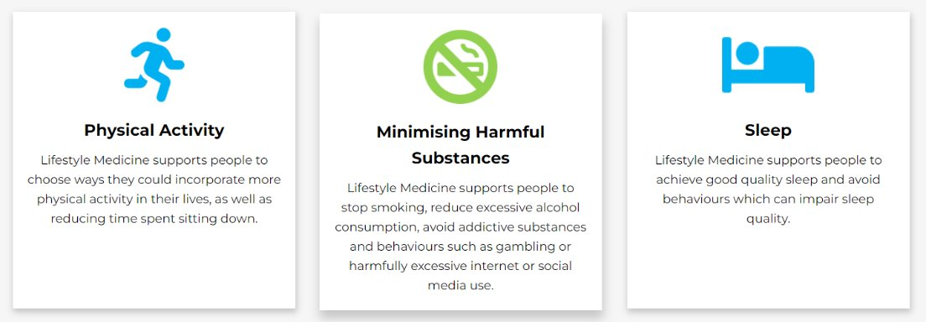
Lifestyle Medicine
Evidence based practice
6 pillars of health
Combines an understanding of the
Upstream determinants of disease
Social situation
Environment
Support patients to make
behaviour change as they wish to
Make an impact as an Individual,
employer, within the community
(GP& PCN) & influencing local policy
Notes:
Share resources & provide credibility
Be a positive role model
Consider ways to better improve our community health e.g. access to healthy food, walking groups, social connection
Offer expertise to elected officials, local decision makers and community organisations

Slide 18
6 Pillar Acronym
Diet Real 'wholefood', plant rich
Relationships Connect with others
Exercise 150m/wk, >65 yrs resistance & balance
Avoiding substances Alcohol, smoking etc
Mental well being Relaxation, mindfulness, breathwork
Sleep 7-9hrs/night, regular sleep times

Slide 19
Exercise
Potential improvement
Prevent 30% Dementia
Prevent 30% Depression
Prevent 25% Breast Cancer
Prevent 40% Heart Disease
Prevent 40% T2DM
Prevent 50% Osteoporosis
Improve cancer recurrent rates
Reduce diabetes complications
Improve heart function
Not the route to sustained weight loss...
Exercise_the_Miracle_Cure_0215.pdf (aomrc.org.uk)​

Slide 20
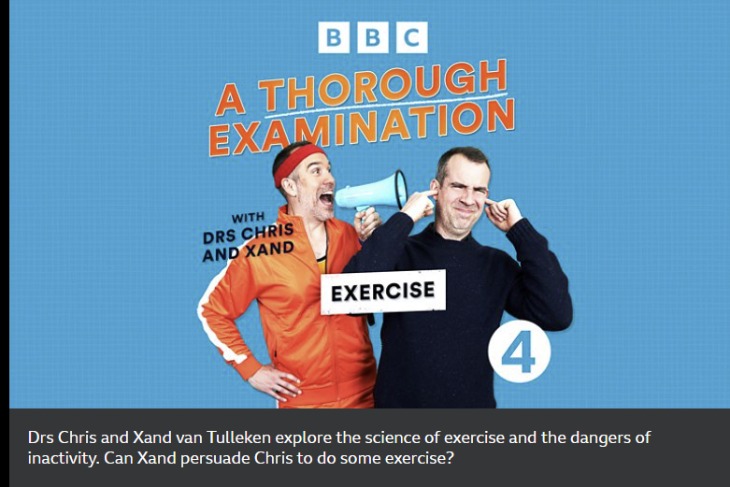
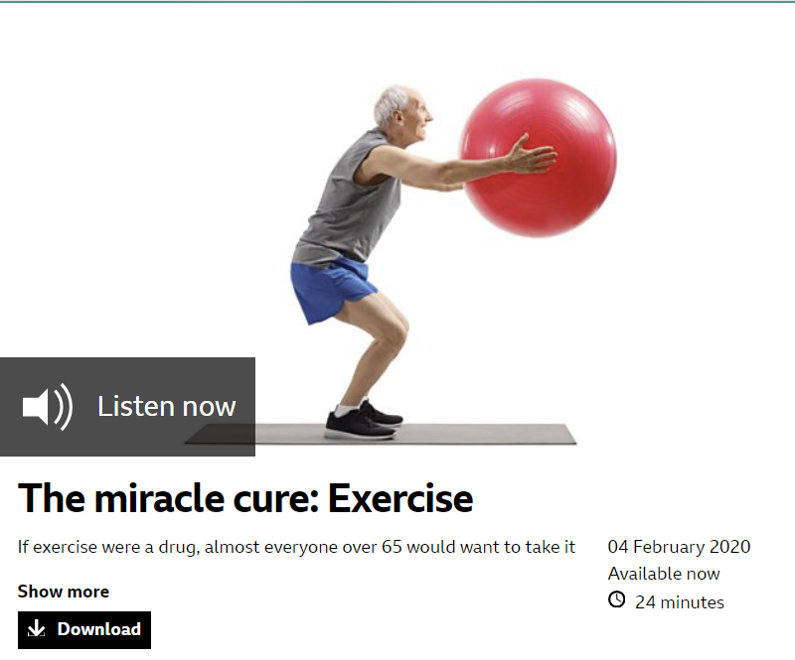
Exercise
BBC Radio 4 - A Thorough Examination with Drs Chris and Xand
Exercise_the_Miracle_Cure_0215.pdf (aomrc.org.uk)
BBC World Service - People Fixing the World, The miracle cure: Exercise

Slide 21
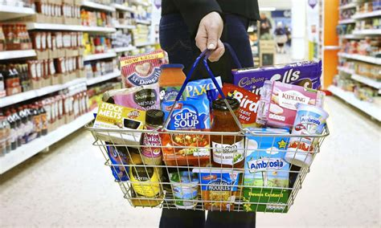
Notes:
Hyperpalatable + low satiety
Easily available & convenient
Often cheap / on offer
Encourage over eating
The more UPFs we eat, the more likely we are obese
UPF make up 60% of children’s daily calorie intake
80% of 1 in 5 children’s intake
Younger people may be particularly susceptible to UPFs

Slide 22
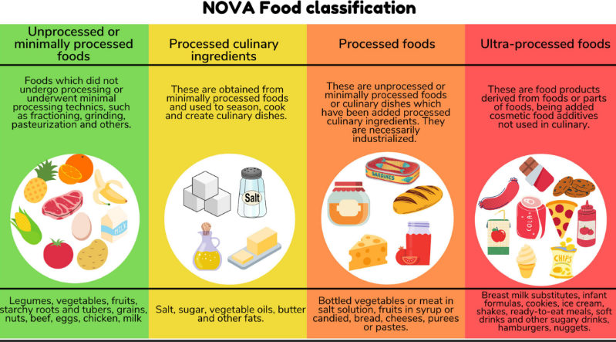
Frontiers | Impacts of Consumption of Ultra-Processed Foods on the Maternal-Child Health: A Systematic Review (frontiersin.org)
Notes:
Food processing has been performed for thousands of years - it is anything that takes food from it’s natural state including drying, milling, canning, adding salt, sugar, fat or preserving
UPFs are not simply foods that have been modified by processing but formulated from food-derived substances to increase their appeal and durability
Mostly full of refined oils, sugars and flour

Slide 23
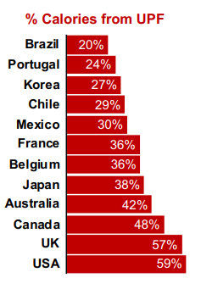
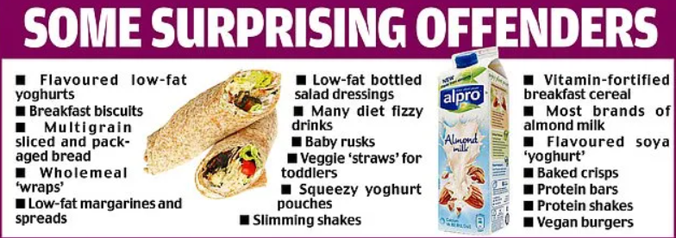
UPF consumption
Ultra-processed foods crammed with sugar and salt account are lurking in places you'd least expect - Sound Health and Lasting Wealth
Notes:
UPFs are the fasting growing segment of global food supply and a major driver of increasing diet-related noncommunicable disease worldwide

Slide 24
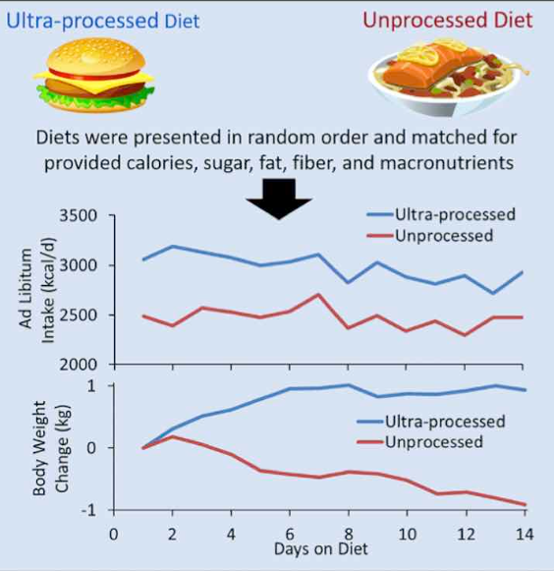
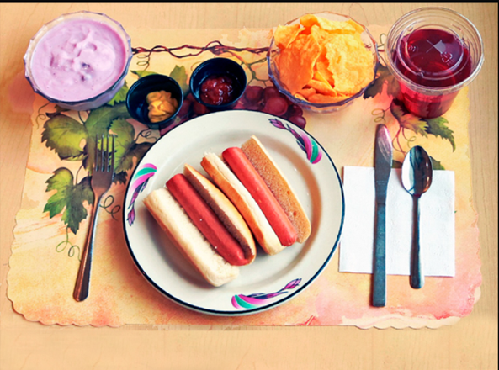
Hall et al., 2019, Cell Metabolism 30, 67–77 July 2, 2019 Published by Elsevier Inc. https://doi.org/10.1016/j.cmet.2019.05.008
Notes:
Kevin Hall’s group took 20 patients who ate a calories, salt, fat and sugar matches diet of unlimited UPF versus unprocessed diet and measures the amounts of calories consumed on eat over 14 days then switched diets – randomly being allocated to UPF or unprocessed first. On average 300 calories consumed per day more consistently and weight gained

Slide 25
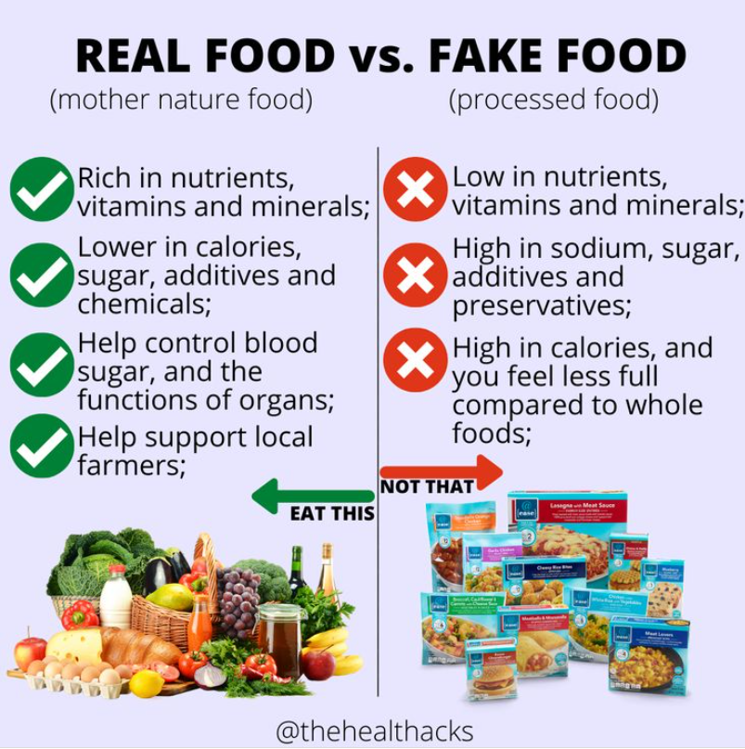
UPF Risks
Increased
Overweight & obesity
Type 2 diabetes
Depression
Heart attacks & strokes
Breast cancer
Frailty
Premature death
Notes:
UPFs high fat / sugar content stimulates dopamine release
‘Dietary pleasure trap’
driving repetitive, automatic behaviour – the more you eat, the stronger the urge - Young people may be particularly susceptible

Slide 26
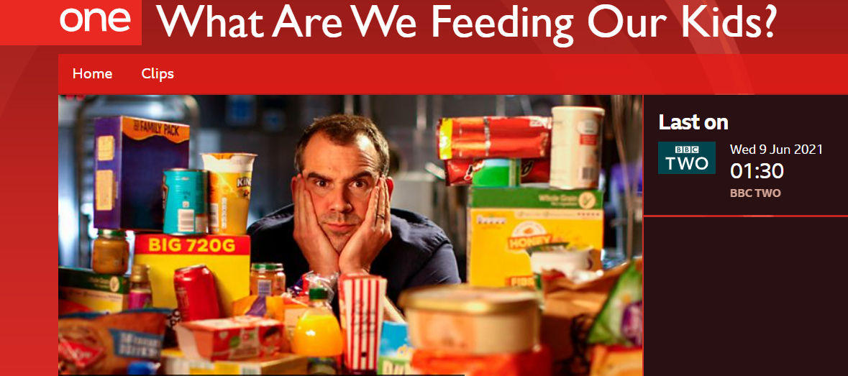
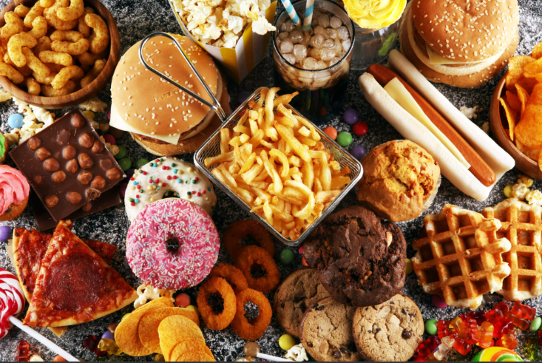
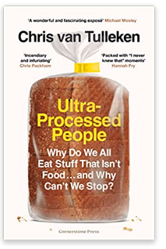
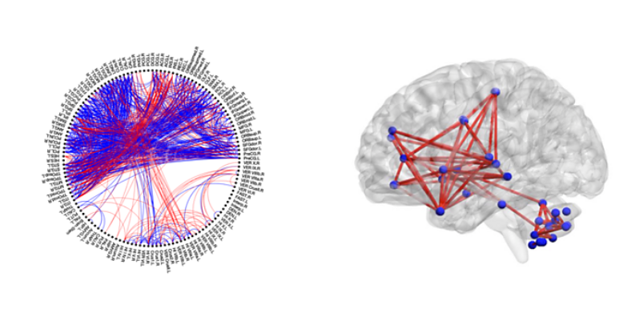
. 2019 Jul 2;30(1):67-77.e3.
Ultra-processed foods – what’s the issue
https://www.youtube.com/watch?v=82kYQ7j7X2s
2021 Sep 1;175(9):e211573
Notes:
Dr Chris van Tukellen – new dopamine pathways developed after 1 month of eating 80% UPFs – persisted 6 weeks later – reward based decision making in pre frontal cortex and automatic behaviours in cerebellum

Slide 27
Potential impact of lifestyle: Med Diet
7557 Spanish Participants
5 year FU
Primary prevention of CVD
30% reduction of cardiovascular events over 5 years
Med diet: plant rich, healthy fats, judicious use of animal proteins, tree nuts +/- olive oil
Primary Prevention of Cardiovascular Disease with a Mediterranean Diet Supplemented with Extra-Virgin Olive Oil or Nuts | New England Journal of Medicine (nejm.org)

Slide 28
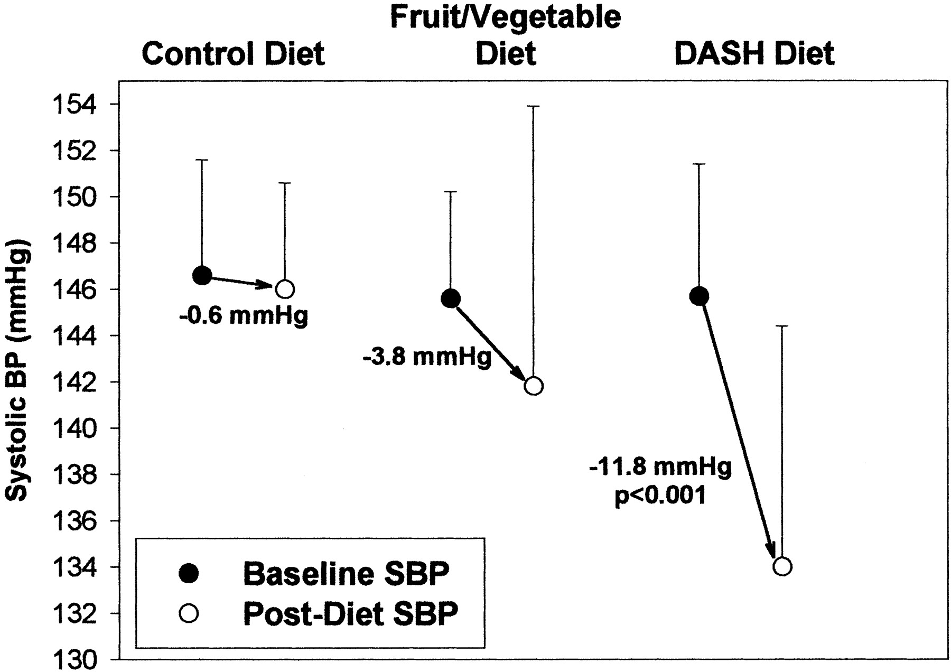
Dietary Approaches to Stop Hypertension : DASH
DASH (Dietary Approaches to Stop Hypertension) Diet Is Effective Treatment for Stage 1 Isolated Systolic Hypertension | Hypertension (ahajournals.org)
Notes:
fruits, vegetables, and low-fat dairy foods, significantly lowers blood pressure.
n the DASH diet group, 18 of 23 participants (78%) reduced their systolic blood pressure to <140 mm Hg, compared with 24% and 50% in the control and fruits/vegetables groups, respectively. In stage 1 hypertension

Slide 29
Diabetes / Pre-diabetes Reversal
Achievable
Enjoyable
Sustainble

Slide 30
Direct Study: Low Calorie Approach
Can Type 2 Diabetes be Reversed or Cured? | Weight loss tips (secondnature.io)

Slide 31
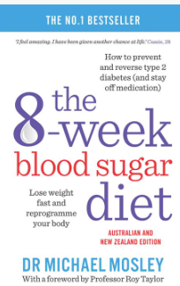
Very Low Calorie Diets: How to do it?
Notes:
Approximately 10% succeed
Vast majority don’t engage long term
Patients often don’t want a book, preferring online info or handouts
After 8 weeks, calorie creep often causes weight gain again

Slide 32
Real world insights: Lower carbohydrate approach (23m)
Participants: 71 Pre diabetic, 128 T2DM patients at Norwood surgery 2013-2019
Method: 1: 1 consultations, supplemented with group consultations, focus on sugar, carbohydrates and higher GI foods. Mean duration 23 months
Results
Median weight drop 99.7Jg to 91.4Kg p< 0.001
Median HbA1c from 65.5. to 48 p<0.001 for diabetic patients
Median HbA1c fall 44 to 39 p<0.001 for pre diabetic patients (93% normal Hba1c)
Drug free T2DM remission 46% participants
Drug budget saving £50885 per year less than average for the area
BMJ Nutrition, Prevention & Health. 2020:bmjnph-2020-000072.

Slide 33
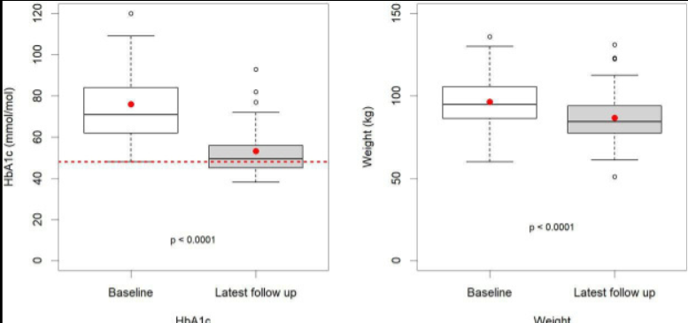
Hba1C and Weight reduction over mean 23m

Slide 34
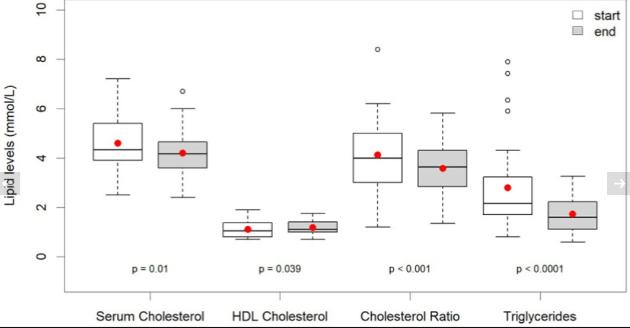
Change in lipids over 23m low carb approach

Slide 35
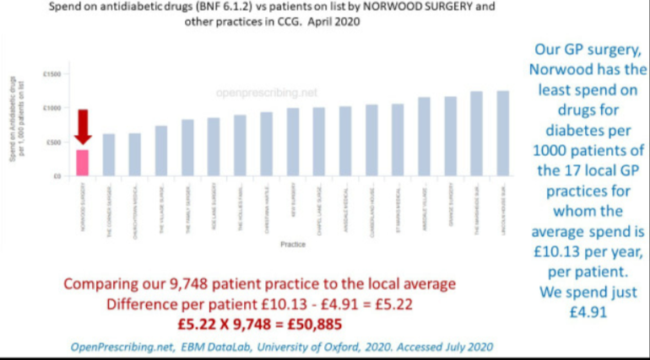
Impact of deprescribing: 21% drug reduction & >£50 000 saving

Slide 36
….8 year data (2023)
39% of T2DM chose to follow low carb approach (n=186)
Average FU 33 months
Mean weight loss 10Kg
Remission achieved in 51% (77% if < 1yr T2DM)
Median HbA1c fall from 63 to 46
Mean LDL cholesterol - 0.5mmol/L, TG - 0.9mmol/L
Mean SBP - 12mmHg
£68 353 less spent per year than average
https://nutrition.bmj.com/content/early/2023/01/02/bmjnph-2022-000544

Slide 37
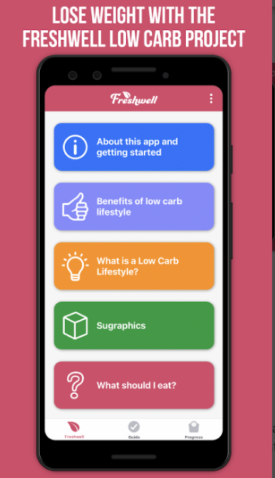
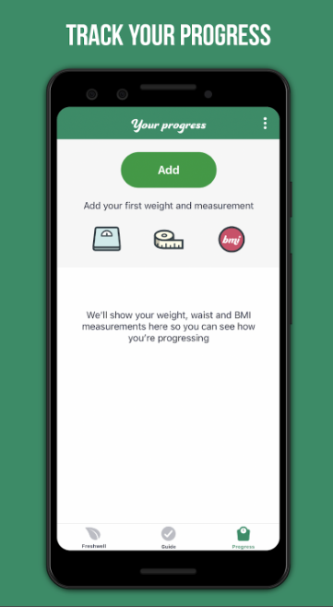
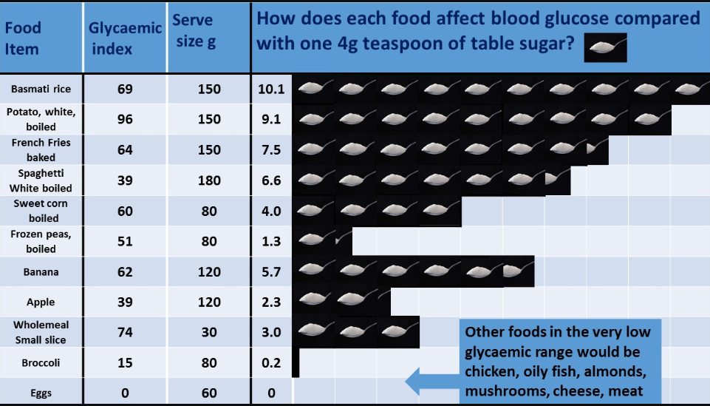
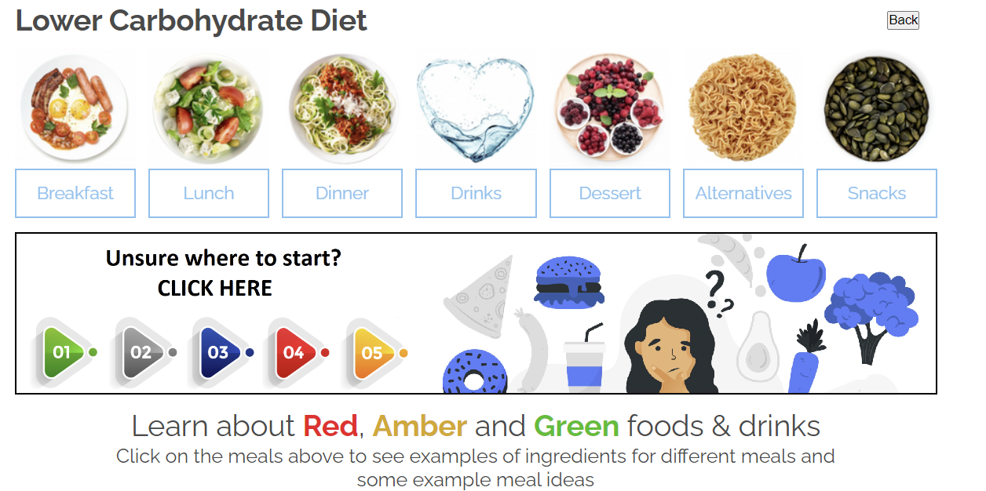
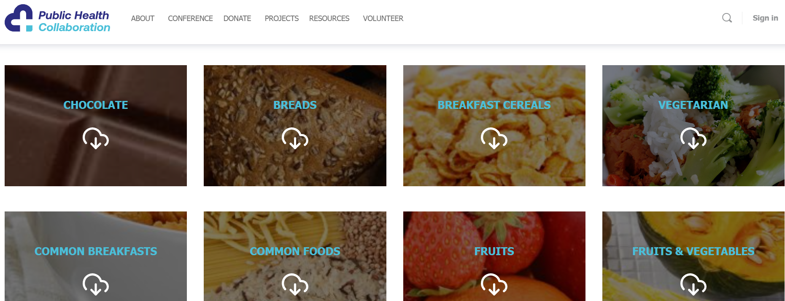
Lower carb approach
https://lowcarbfreshwell.co.uk/
https://phcuk.org/sugar/​ Sugargraphhics
Low Carb | New Forest PCN

Slide 38
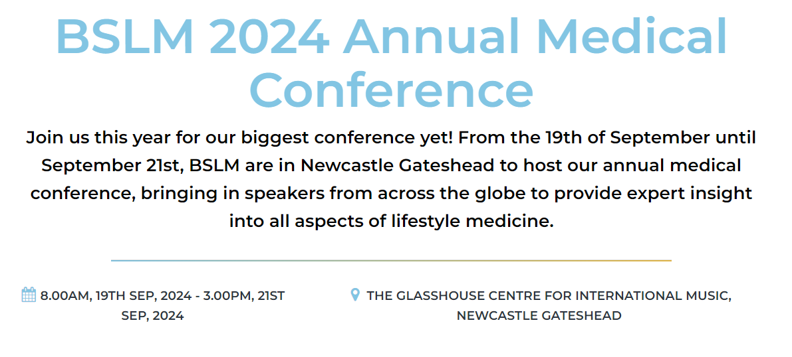
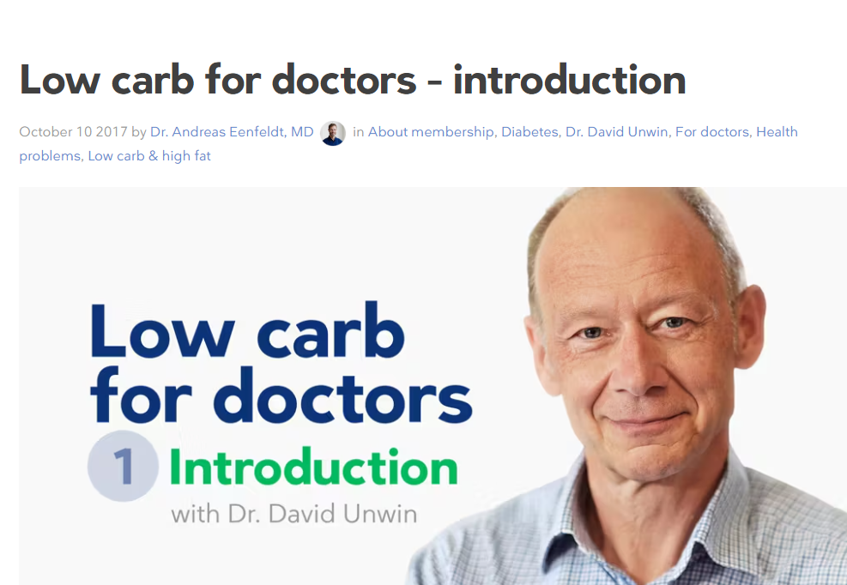
https://www.drdavidcavan.com/for-professionals
3rd Primary Care Lifestyle Conference Tickets, Mon, Sep 16, 2024 at 9:00 AM | Eventbrite
BSLM 2024 Annual Medical Conference - British Society of Lifestyle Medicine
https://www.dietdoctor.com/low-carb-doctors-introduction

Slide 39
How to support behaviour change

Slide 40
Three key steps to support behaviour change for HCPs
Ask permission to discuss - ask questions, don't lecture
Connect with their 'Why'
Start small - keep it simple & achievable
Help patients identify one small change they could make every time you prescribe – little steps to achieve their DREAMS

Slide 41
Tips to support behavioural change
To ask questions, allowing patients to come up with their own answers, telling them what to do does not create action
Ask permission to discuss other ways to help manage symptoms or if they would be interested to consider an alternative to medication
Check what their understanding is so far
What have they done before – what has worked / hasn't worked?
What would they like to have happen
What difference would it make to them if they could achieve this?
Do they have a good idea of how they could do this? If not or you think there could be better ways, ask permission to share.
What could help to keep them accountable to this change
Keep it simple – what one change could they make to start on the journey to their goal and when are they going to do this
Support with resources

Slide 42
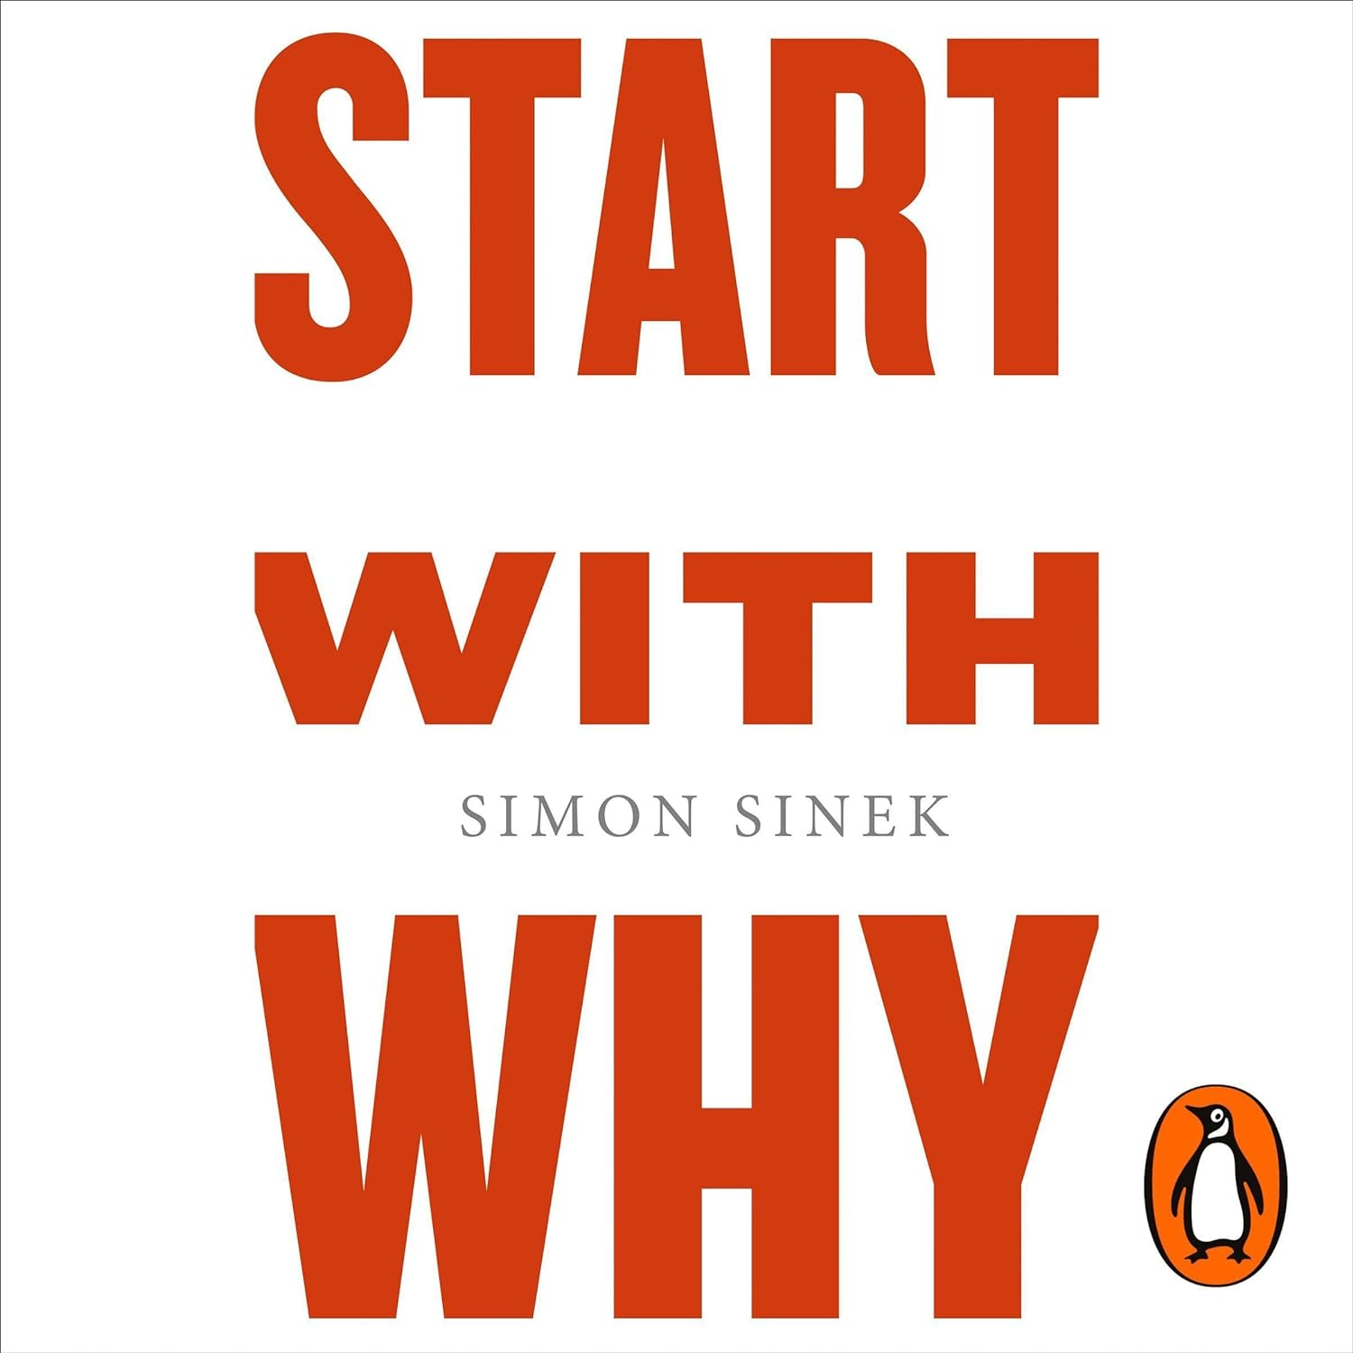
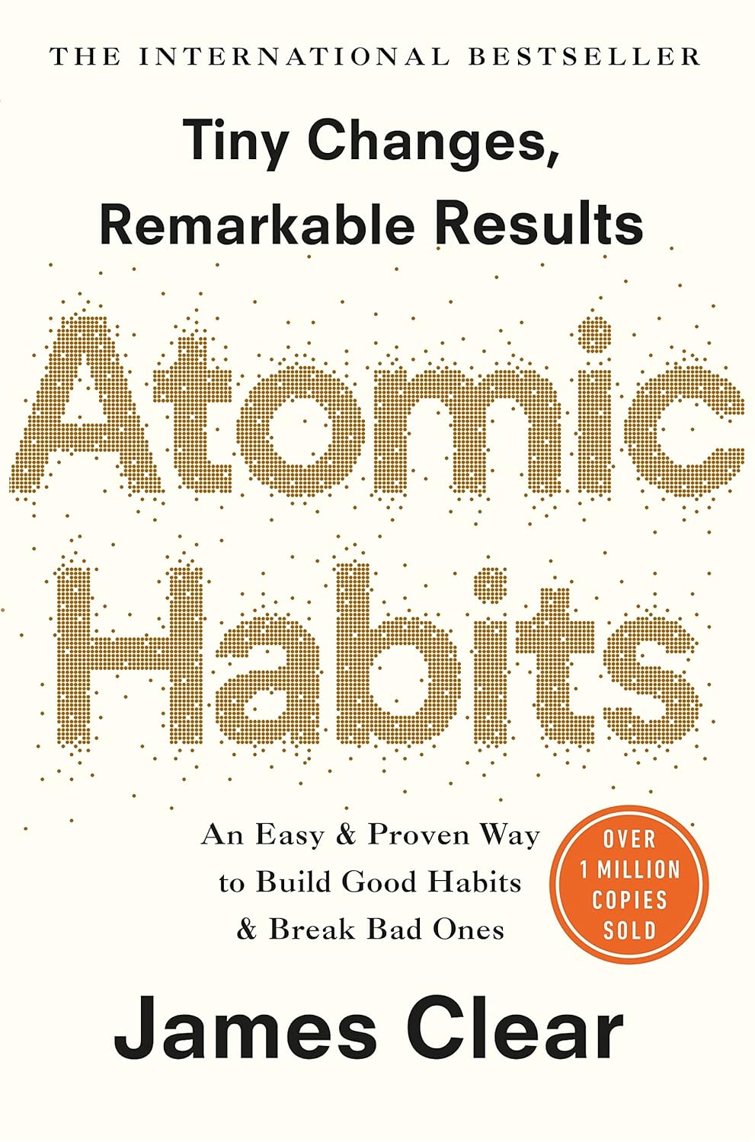
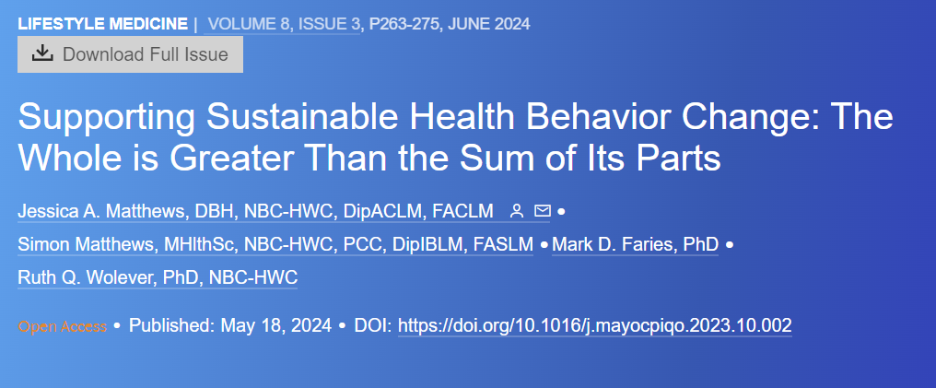
Health Behaviour Change Resources
Supporting Sustainable Health Behavior Change: The Whole is Greater Than the Sum of Its Parts - Mayo Clinic Proceedings: Innovations, Quality & Outcomes (mcpiqojournal.org)

Slide 43
Summary
Global Syndemic Health & Climate crisis
Lifestyle medicine – what is it and why does it matter
Lifestyle approach to metabolic health
Practical tips
What one small change can they make to help them start to achieve their DREAMS
Useful resources & CPD

Slide 44
Which would you prefer?
Vs
Caroline Butler
c.butler@nhs.net
Notes:
The medical term given to how we use energy to fuel our body is our metabolic health. It’s useful to think of our metabolism as similar to a car engine.
If we supply our bodies with the right kind of fuel, we can supply our bodies with the right energy when we need to and store energy for later use when it is needed. You feel energised, alert, think more clearly, sleep better, can fight infections, repair body parts if they are damaged and you are more likely to be healthy. Your engine is working well and staying in good repair.
If on the other hand you supply your body with the wrong fuel and don’t look after it, similar to putting the wrong kind of fuel into a car’s engine, you can cause damage. We feel tired, lacking in energy, frequently hungry, struggling with aches and pains, have difficulty loosing weight, especially around out middles and sometimes feel low and depressed.

