Slide 1

Exercise for patients with Chronic Kidney Disease
Green Nephrology 2013
Sharlene Greenwood

Slide 2
Why is exercise important in CKD
Muscle wasting and weakness
Cardiovascular disease leading cause of death in CKD
Impaired capacity for activities of daily living
Effects of exercise rehabilitation interventions well documented
Routine physical rehabilitation for patients with CKD is rare
Notes:
Due to a number of factors muscle wasting is almost universal across all patients with CKD and we know that this gets worse as the disease process progresses.
Patients with CKD typically have approximately 50% of the exercise capacity of non-uraemic, healthy, sedentary people. Physical inactivity doubles the risk of developing heart disease AND Cardiovascular disease remains the leading cause of death in patients with CKD.
Our patients have an impaired capacity to carry out activities of daily living, and although the Kidney Disease Outcomes Quality Initiative (K/DOQI) clinical practice guidelines and the recently published Cochrane review by Susanne Hiewe recommend increased levels of physical activity in dialysis patients on the basis of several randomised trials, routine physical rehabilitation for patients approaching end stage renal disease remains rare and sporadic, and exercise programmes for transplant and pre-dialysis patients is practically non-existant.
2

Slide 3
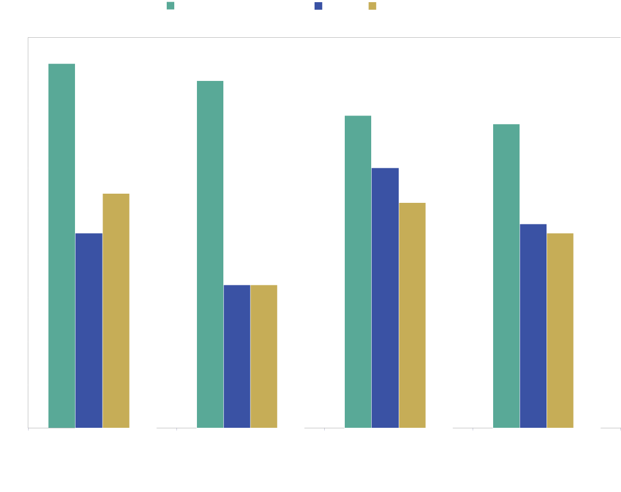
SF-36 scores in chronic disease
CHF = chronic heart failure; COPD = chronic obstructive pulmonary disease; ESRF = end stage renal failure
Curtin RB et al. Adv Ren Rep Therap 1999; 6(2): 133–140
Notes:
This chart shows the SF-36 scores of the general population with age and gender matched patients with three chronic diseases heart failure in the dark blue, COPD in the orange, and CKD in the white. There is an obvious drop from general population to these groups in the physical sections of this self-reported outcome measure. However, unlike CHF and COPD where rehab programmes are the norm, this type of approach is not routinely offered to our patients with CKD.

Slide 4
Muscle weakness and wasting
Physical function and CKD
Physical inactivity
Anaemia
Aging
Decreased dietary intake
Comorbidity
Muscle protein
catabolism > synthesis
Dialysis
↓VO₂ peak
Notes:
There are a number of factors which affect physical functioning in patients with CKD, particularly in dialysis patients. Anaemia, the effects of the aging process, comorbidity such as diabetes, the effects of dialysis, the rate of muscle protein break down exceeding the rate it is produced, and the effects of a decreased dietary intake. All these processes coupled with physical inactivity, the sedentary lifestyle adopted by many patients with CKD collectively have a major impact on muscles, causing muscle weakness and wasting.This in turn causes a decrease in exercise capacity and function which can be seen by doing exercise testing such as VO2peak cardiopulmonary testing.

Slide 5
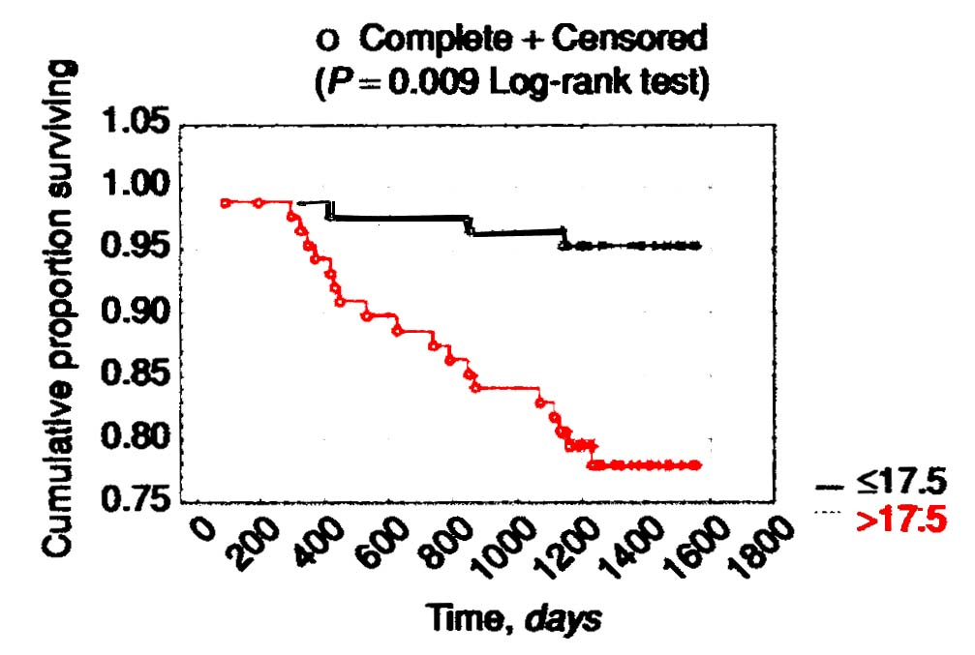
VO₂ _{peak} and Survival
Survival as function of baseline VO_{2peak} for 175 ambulatory ESRD patients
>
≤
(Sietsema et al (2004) Kidney International, 65, 719-724)
Notes:
This graph shows the results from Kathy Sietsema’s study which evaluated the effect of exercise capacity on survival in175 dialysis patients. She showed that there was a distinct survival advantage for those patients who were able to achieve above 17.5l/kg/min during VO2 peak cardiopulmonary testing when patients started dialysis.

Slide 6
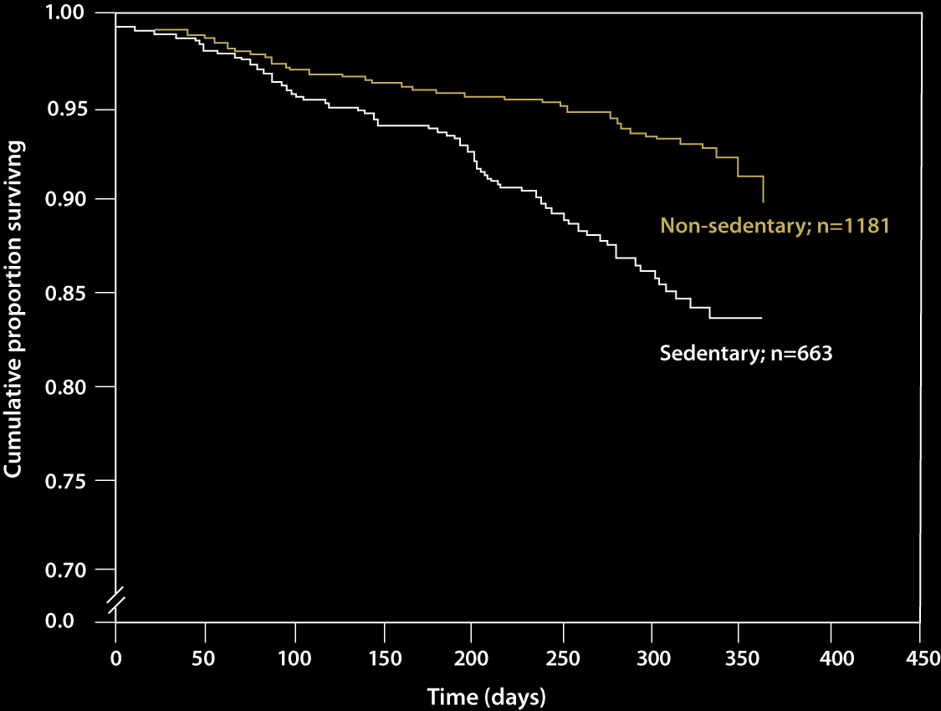
Inactivity and survival on dialysis
2264 incident dialysis patients; sedentary, active; 9–12-month survival
O’Hare AM et al. Am J Kid Dis 2003; 41(2): 447–454
Notes:
Another study, this one by O’hare et al shows the progressive improvement in survival year on year for non-sedentary versus sedentary patients on dialysis.

Slide 7
Deficits in physical function between ESRF patients and normal patients
Patients Healthy % deficit
(n=45) controls
(n=22)
VO2peak (ml.kg.min-1) 17.6±6.1 26.2±9.1 33
STS60 (n) 21.2±7.5 30.2±6.2 30
STS5 (secs) 15.7±11.5 9.8±3.5 60
Stair climb (secs) 14.6±9.2 8.4±2. 74
Stair descent (secs) 16.9±11.8 9.2±2.8 84
Naish P. Unpublished observations
Notes:
A study by Patrick Naish and Tom Mercer compared dialysis patients with age, gender and physical activity matched subjects in a number of exercise tests. These are the results.
Once again, you have the VO2 peak measure. Here we see a 33% deficit when comparing the patients with the control group.
The Sit to stand 60, a measure well used to determine function where the subject completes their maximum sit to stand transfers in 60 seconds.
The Sit to stand 5 is a similar test the time taken to do 5 sit to stand transfers is measured.
And lastly, an important measure of function – a Stair climb / descent, measured using 22 steps, showed a massive 74 and 84% deficit respectively.

Slide 8
The evidence
30 years of research investigations into effects of exercise training on physiological and patient outcomes
4 systematic and meta-analytic reviews
  Cheema and Singh 2005
  Segura-Orti 2010
  Smart and Steele 2011
  Heiwe and Jacobson 2011
Notes:
So, now that we have had a brief look at why we think it is important for patients to do some activity, lets take abrief look at the evidence we have to support this.
As it stands, there is over thirty years of research investigations into the effects of exercise training interventions on various physiological but also patient relevant outcomes.
There are 4 published systematic and meta-analytic reviews – Bobby cheema’s rview from 2005, Eva Sgura-orti’s review from 2010 and then the smart and steele review from the australian group, and the log-awaited cochrane review from the Karolinska institute in 2011.
I will briefly summarise the conclusions from these reviews which are based on randomised controlled exercise trials in patients with CKD.
8

Slide 9
Aerobic exercise
Indices of CV fitness
- Improved VO2 peak (17-50%)
-Dialysis v Non-dialysis
Functional capacity
-No significant objective improvements
-Small number RCT’s, Specificity of training
Quality of life Indices
- Improvements in physical component
Notes:
Aerobic only based exercise training performed during dialysis or on an off dialysis day significantly and to a large extent improves cardiovascular fitness
The trials mainly used VO2 peak as an outcome measure and showed improvements from 17 to 50% in some cases.
When comparing the effectiveness of exercise programmes implemented during dialysis or on a non dialysis day,. It appears that although non-dialysis exercise is more effective, there are also larger drop-outs. It may be slightly unrealistic to expect patients receiving hospital-delivered haemodialysis 3 times a week to attend additional hospital or community based exercise classes on non dialysis days at least in the UK environment.
Unfortunately, the aerobic only based exercise did not seem to significantly improve objectively measures of functional capacity that relates to activities of daily living such as walking capacity, ability to stand up from a chair, stair climbing etc . A likely reason for this surprising lack of effect, could be the relatively small number of studies (4) and thus patients who were analysed (n=71), or the fact that in order to gain improvements in functional measures, specific training regimes may need to implemented.
Quality of life seemed to be improved overall but the majority of studies report improvements in the physical component subscores, with only random improvements in other elements of quality of life such as vitality, social function, general health.
9

Slide 10
Resistance only exercise
Very small number RCT’s (4)
No index of CV fitness
Muscle strength and cross-sectional area improved (Hiewe 2011)
2 studies - no difference in strength and functional capacity, but large significant changes in HRQOL
(Johansen et al 2006, Cheema et al 2007)
Notes:
Only 4 RCTs used resistance only training prescription. None had an index of CV fitness as an outcome and thus currently we do not know whether resistance training on its own can affect the important component of health related fitness which is cardiovascular fitness, however muscle strength and cross-sectional area was significantly and to a large extent improved as indicated by the meta-analysis of Heiwe and Jacobson (2011) but not confirmed in the meta-analysis by Segura Orti (2010). The reason for this could be that Segura Orti (2010) included 2 studies in the analysis which did not show significant changes in any strength and functional capacity outcomes but reported a really large and significant improvement in health related quality of indices, which seem to be driven by the self reported physical function components of the SF-36 questionnaire that was used (Johansen et al 2006, Cheema et al 2007). This observation highlights the discrepancy between objectively measured and subjectively perceived ability to perform physical tasks that relate to activities of daily living. This dissociation between objective and subjective measures of functional performance does not minimise the importance of someone’s perceived ability to perform a task, as the individual is more likely to actually perform a task if she/he thinks is achievable, therefore more likely to engage in active living.
10

Slide 11
Resistance and aerobic training
9 studies used combination training
Demonstrated large effects on indices of CV fitness, not accompanied by improvements in functional capacity indices
Significant improvements in resting diastolic and systolic blood pressures following any type of exercise training for at least 6 months.
Notes:
When looking at resistance and aerobic training, 9 studies that have used combination training regimens demonstrated significant and large effects in cardiovascular fitness especially after 6 months of training intervention. These large improvements in CV fitness did not seem to be accompanied by significant changes in functional capacity indices such as STS and walking performance (Segura Orti 2010). On closer examination of the data, it seems that the large changes in CV indices are driven by a number of studies by the same research group (Deligiannis et al. 1999, Kontantinidou et al 2002, Ouzouni et al 2009, Kouidi et al. 2009) who report substantially larger % changes in VO₂ peak indices compared to the average values reported in the literature, but unfortunately they do not report accompanying indices of functional capacity from their patients to allow evaluation of the relationship between large CV fitness improvement and the extent of corresponding functional improvements.
The meta-analysis of Heiwe and Jacobson (2011) also reports significant and substantial improvements in resting diastolic and systolic blood pressures following any type of exercise training for at least 6 months. Extreme caution should be applied in the interpretation of these observations as BP was never really reported as a main outcome of interest in all the studies included in the meta-analyses.
11

Slide 12
Exercise and the environment
Obesity
CVD
Quality of life
Fatigue
Depression
Exercise
Rehabilitation
Diabetes
Mobility
Self efficacy
BP
Dialysis
adequacy
Notes:
So, having given you a brief overview of the hard evidence we have from the available RCT in the literature, I wanted to extend this to include some of the other published work, and describe some of the potential benefits that exercise therapy may have on the environment.
Following my invitation to speak at this green nephrology event, my team and I spent some time brainstorming ideas and came up with the following –
improvements in quality of life,and reduction in depression and anxiety which may reduce reliance on medication
Improvements in mobility and independence which may reduce reliance on mobility aids and transport
Reduction in BP which again may reduce reliance or the amount of antihypertensive medication used
Improvements in dialysis adequacy which have been shown in small studies by Kong et al and Trisha Parsons group may decrease dialysis time
Improvements in self efficacy, again may mean less reliance on hospital systems
Improvements in diabetic control decreases levels of insulin required, or in some cases can reduce the need for medication
Exercise training may limit post-dialysis fatigue, again perhaps reducing the need for transport
The potential for decreasing the burden of CVD with exercise training, as a part of the wider plan, has potential to reduce hospitalisation and the corresponding costs in terms of healthcare and the environment
Lastly, the ever-growing burden of obesity can be minimised with exercise training as again, part of a wider plan, to reduce associated costs.

Slide 13

Exercise training for patients with CKD

Slide 14
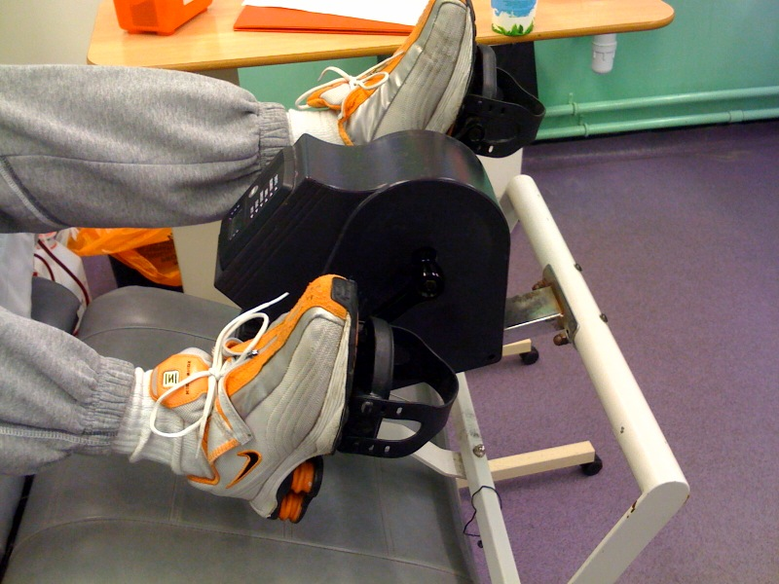
Exercise on dialysis

Slide 15
Exercise on dialysis
Captive audience – will enhance adherence
Supervised by dialysis staff
Medical surveillance
Motivation from staff and peers
No extra time required (reduce patient time burden)
May stabilise haemodynamics during the treatment
Less cramping / hypotension
Less post-dialysis fatigue / stiffness
Increased protein uptake (with IDPN – Pupim et al)
Increased clearance of K+, reduced rebound of urea, creatinine,K+ (Viathlinigading, Kong, Parsons)

Slide 16
Changes environment in the unit from ‘illness’ to ‘wellness’
Changes staff attitudes / expectations of patients (and patient expectations for their life on dialysis)
If a part of routine treatment, then will be more sustainable
FUN!

Slide 17
Potential barriers
Potential Barriers
Efficient use of time – sleep disorders
Lack of research – safety, effectiveness
What type of equipment to use?
Space in the unit
Satellite units
TIME / Finance for staff
Monitoring the programme
Fatigue, especially post-dialysis
Lack of motivation
Multiple hospital visits (dialysis 3X / week)
Weight gain – nutritional difficulties
Anaemia
Fistula / PD access – use of weights / swimming
Medication side effects
Peripheral neuropathies (diabetics)
Getting the patient on board!
Notes:
Time for patients to catch up on sleep
Safety – no specific study to date has systematically compared the risk of adverse events between different models of exercise programme delivery
Effective? – Only so many types of activity you can do while tethered to a dialysis machine
Evidence suggests that extr-dialytic exercise using a vareity of madalities is really the most effective way to achieve gains in aerobic fitness and cardiovascular status.
Getting patient on board – motivation, fatigue, uncomfortable to sit in sweaty clothes, lack of privacy, suitable clothing

Slide 18
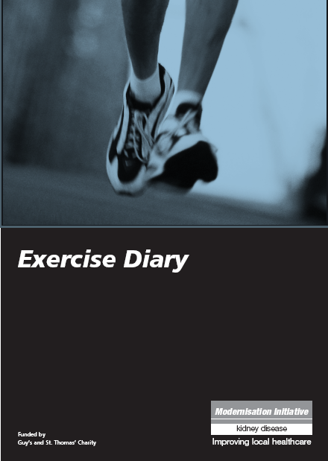
Other exercise options!
Renal Rehabilitation class
Home exercise program – walking and cycling diaries
Exercise on Referral Gym program

Slide 19
The current position
Enthusiastic researchers and clinicians
Good quality research
Existing NHS renal exercise programmes
Adopted by BRS
Collaborative links
Difficult financial climate

Slide 20
The next steps…
Exercise and haemodialysis – NIHR HTA bid – The PEDAL Trial
The effects of exercise on the prevention of CVD / progression of CKD in the pre-dialysis population
The effects of exercise on long-term KTx outcomes, and cardiovascular risk

Slide 21
The future
High quality collaborative research
A marriage of research and clinical ideals
Prevention and rehabilitation in the NHS
Increasing the profile of exercise and CKD
Influencing policy
Increasing collaborative links
Notes:
Research consortium
Ramit
21

Slide 22
BRS RN
British Renal Society Rehab Network
100+ members
Task and finish work stream
Website
Support research and clinical implementation of exercise for patients with CKD
sharlene.greenwood@nhs.net
Notes:
22

