Slide 1
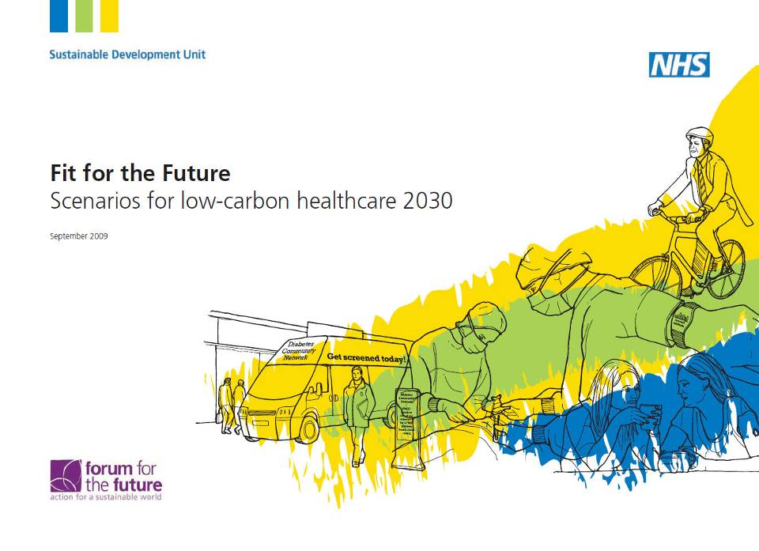
Delivering A Sustainable NHS Sustainable Development NHS England 2012
Notes:
Theme – workforce of the next 40years key to delivering sustainable NHS, this group of people are key influencers of workforce
Audience – global lecturers / teachers of nursing / AHPs
You’ll want to embed to this
UK – amazing opportunities / amazing resource

Slide 2
Why? The NHS can have a huge impact
Notes:
As of 30/09/2011 – 1,350,377 of those 370,327 qualified nurses and 74,647 qualified AHPs. The number of patients using the NHS is equally huge on average dealing with 1 million patients every 36 hours. That’s 463 people a minute, or almost 8 a second.

Slide 3
Why? Results of Public Opinion Survey
Source:
Ipsos MORI
http://www.sdu.nhs.uk/healthcheck2012
http://tiny.cc/w7fg5
Notes:
Key slide – public want the NHS to set an example – look to NHS to be a role model

Slide 4
Why? What is good for sustainability is good for healthcare
For healthy people
more physical activity
better diet
improved mental health
less road trauma
less air pollution
less obesity/ heart disease/cancer
more social inclusion...
Notes:
If we get it right ++++

Slide 5
Why? What is good for sustainability is good for healthcare
For a more innovative healthcare system
more prevention
care closer to home
more empowered / self care
better use of drugs
better use of information and IT
fewer unnecessary admissions
better models of care…

Slide 6
Climate Change Act 2008 (1) It is the duty of the Secretary of State to ensure that the net UK carbon account for the year 2050 is at least 80% lower than the 1990 baseline
Why?

Slide 7
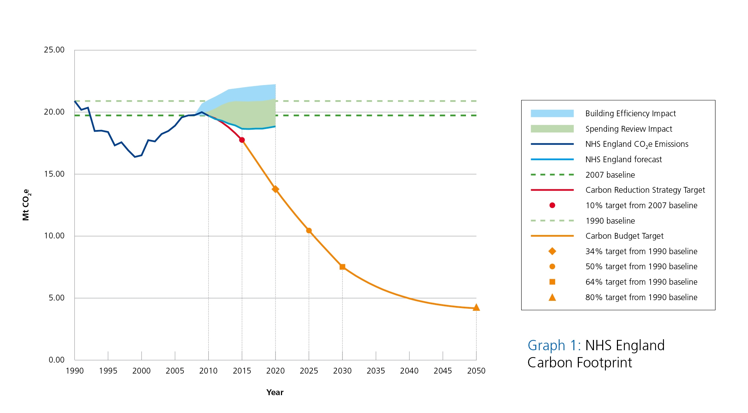
Why? NHS Carbon Footprint
Notes:
The NHS is the largest public sector contributor to climate change in Europe. Each year it emits 21 million tonnes of carbon dioxide equivalent or CO₂e
Major contributor & necessity to respond to CC

Slide 8
How? Breakdown of NHS England 2010 emissions

Slide 9
How? Procurement Breakdown

Slide 10
How? Potential Reductions
Notes:
Energy and Carbon, Procurement and Food, Travel and Transport, Waste, Water, Design of Built Environment, Organisational and Workforce Development, Partnerships and Networks, Governance, Finance, Looking Ahead

Slide 11
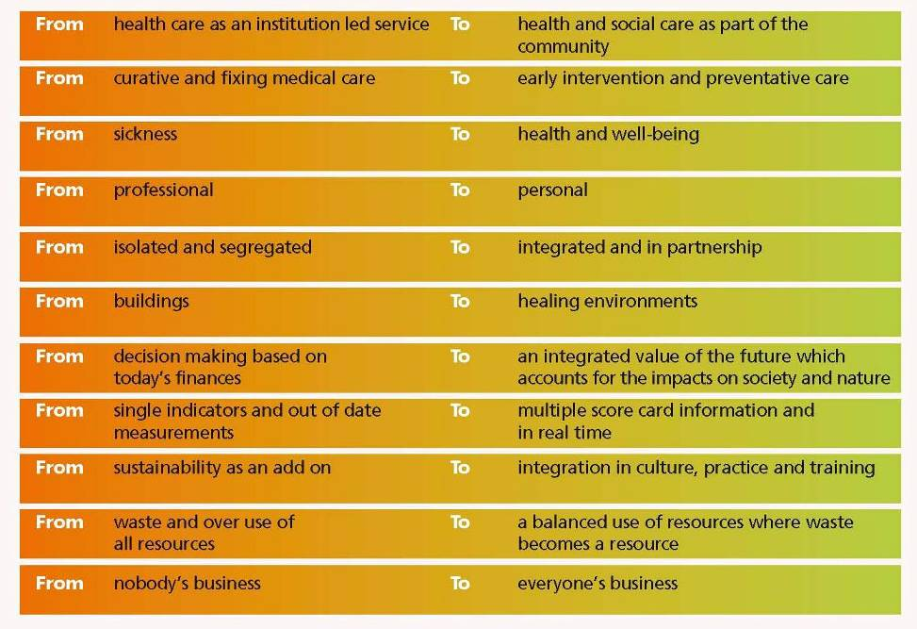
Notes:
Spur for change / opportunities

Slide 12
NHS Sustainable Development Unit
help develop organisations, people & tools
help develop policy & research
source of leadership, expertise & guidance
raise awareness of the actions & responsibilities of the NHS regarding sustainable development & climate change
promote a culture of measurement & management which leads to a process of carbon governance
help shape NHS policy, locally, nationally & internationally
ensure the very best practice & innovations on sustainability in the NHS & elsewhere are evaluated & costed
ensure the mechanisms for implementation of these innovations are made fully available to all NHS organisations.

Slide 13
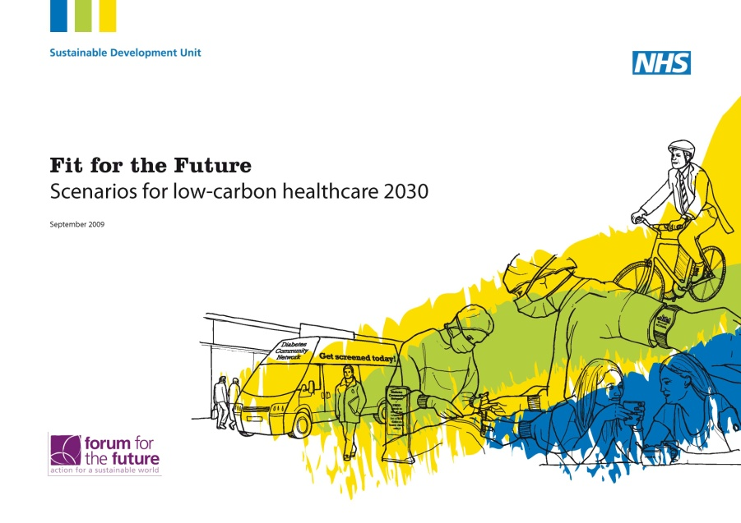
Notes:
Reading the pledge and these three key publications will give many actions that can be taken now.
Just SOME of the actions that can be taken:
At an individual level
Measure your carbon footprint
Understand exactly where you use energy and how you can reduce it.
Think tonnes or kgs of Carbon dioxide rather than just KWH
Understand what low carbon and active travel really is and live it – walk, bike, public transport
Think about the carbon and climate consequences of the way we/you eat, everything from food miles, to waste, to supporting local producers an retailers to the carbon consequences ad health consequences of high meat and dairy diets
At an organisational level
Ensure your workplace really provides low carbon transport options, buses, liftshare, cycle paths, racks, showers, lockers...
Is there a sustainable development or climate change staff group that tackles things from the ground up?
Has there been a organisational carbon footprinting or auditing process done?
Ensure the head of your unit / line manager / Chief Executive, knows that MANY health professionals are seriously concerned. Numbers matter.
Set an example to other staff, patients and visitors
Is climate change on the risk register of your organisation?
Is your organisation part of the carbon Reduction Commitment from April 2010?
Is sustainability built into the measurement of performance of your organisation?
How much renewable energy does your organisation buy, and could it buy more?
Is your organisation explicit about what it’s climate impact is and what it is doing about it?
Is there a procurement policy in your organisation that reduces the climate/carbon impact?
Is the leadership team in your organisation aware of the many immediate health co-benefits that can be gained from immediate action – health, lives, money and reputation...?
At a political level
Write to your MP and get you family friends and colleagues to do the same.
Contact them well before the next round of international agreements are made in Copenhagen, Nov 2009 and ask tem where they stand.
13

Slide 14
When the winds of change blow, some people build walls and others build windmills (Chinese proverb)

