Slide 1
Sustainable Healthcare
Eleanor Denny
SSC: Holistic Medicine, Dr Craig Brown

Slide 2
Overview
On a global scale
In the NHS
In the specialties
How can medical student and doctors help?

Slide 3
Why should I care about climate change? ...I want to be a doctor!
Climate change has been identified as the greatest threat to global health in the 21st century
(UCL/Lancet Commission, May 2009)

Slide 4
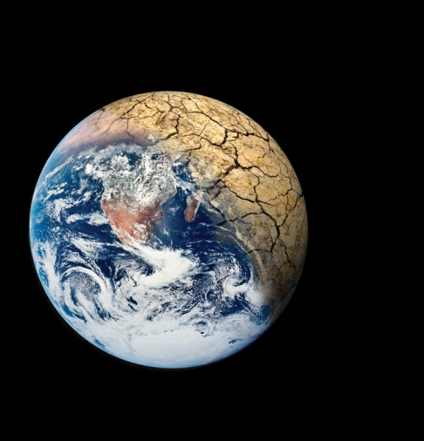
Global warming affects Global health
Climate change is not just an environmental issue – it is a health issue
Factors affecting global health:
Changing patterns of vector disease
Water & sanitation
Food
Shelter
Extreme events
Population and migration
Notes:
Climate change is amplifying problems already faced by developing countries
Vector disease – dengue and malaria, increasing area of transmission
Water – flooding and scarcity (unpredictability)
Food - climate change affects crops, forestry, livestock, fisheries, aquaculture, and water systems

Slide 5
The relationship is disproportional…
Climate change effects on health will exacerbate inequities between rich and poor
First world countries account for 90% of the worlds carbon emissions
Third world countries will be most affected by poor health caused as a result

Slide 7
Closer to home...

Slide 8
Global warming and the NHS
The NHS is responsible for the admission of 18 million tonnes of CO2 every year
That is 40% of public sector emissions in the UK!
Not just heating and lighting
Pharmaceutical manufacture makes up 20% of total emissions

Slide 9
Cutting emissions in the NHS
Carbon reduction strategy to reduce carbon emissions by 80% over the next 30 years.
Push to make environmental sustainability as important as financial sustainability.
=

Slide 10
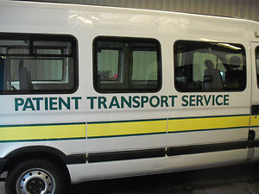
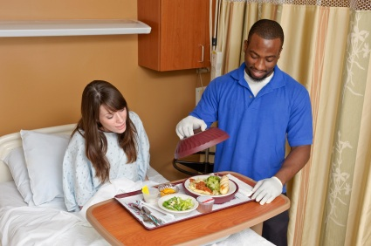
What can the NHS do to meet these targets?
Reduce and safely dispose of waste
Use energy efficiently and switch to renewable energy
Improve travel strategies
Purchase and serve sustainably grown food
Adopt greener building design and construction
Notes:
• Prioritise environmental health
• Substitute harmful chemicals with safer alternatives
• Reduce and safely dispose of waste
• Use energy efficiently and switch to renewable energy
• Reduce water consumption
• Improve travel strategies
• Purchase and serve sustainably grown food
• Safely manage and dispose of pharmaceuticals
• Adopt greener building design and construction
• Purchase safer more sustainable products

Slide 11
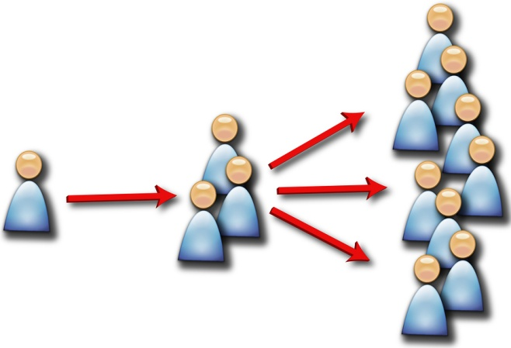
Can the NHS set a good example to the rest of the UK?
Hugely ingrained in society
Large network of health care professionals
Millions of people access the NHS regularly
....Spread the word!

Slide 12
Sustainable Specialities
Green Nephrology Network:
Leading specialty in sustainable health care
Over 80% of kidney units have a rep
Differences are made at a local level
Inspiring other specialties to do the same

Slide 13
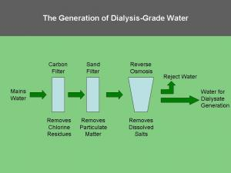
Conserving water in haemodialysis
A local example from East Kent Hospitals University Foundation Trust
Dialysis machines require 400l of water for a standard 4 hour session
Water is intensely refined using ‘reverse osmosis’
2/3 of the water is rejected by this process
Rejected water is now recycled into hospital toilets
Notes:
A 4 hour session of dialysis usually uses 400l of water.
Reverse osmosis is an important step in the purification process for water used in haemodialysis. Reverse osmosis systems reject up to two thirds of the water presented to them. This 'reject water' does not come into contact with the patient at any stage and poses no infection risk, yet it is 'lost to drain' in almost all dialysis facilities.

Slide 14
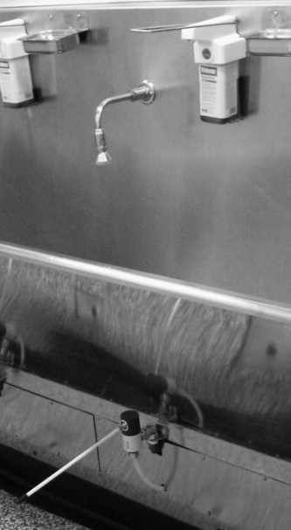
Will ophthalmology be the next green specialty?
Climate change predicted to have a significant impact on eye disease
Many innovative ideas:
Reusable, sterilized equipment
Introducing mobile units
Knee operated scrub taps
And still only 6 months old!

Slide 15
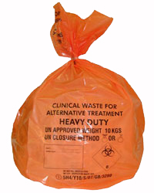
What can medical students do?
Find out more and spread the word
Walk, cycle or car share to the hospital
Keep clean stuff out of the orange bins
Watch the Age of Stupid
Calculate your carbon footprint
Print on double sides when on the wards

Slide 16
Any Questions?

Slide 17
References
Mortimer, F. The sustainable physician. Clinical Medicine 2010, Vol 10, No 2: 110–11.
Moynihan, R. The greening of medicine. BMJ 2012 Jan.
Costello A et al. Managing the health effects of climate change. UCL/Lancet 2009; 373:1693-1733.
http://sustainablehealthcare.org.uk/
Thanks to Frances Mortimer Medical Director of the Centre for Sustainable Healthcare for supplying leaflets

